Slide 1
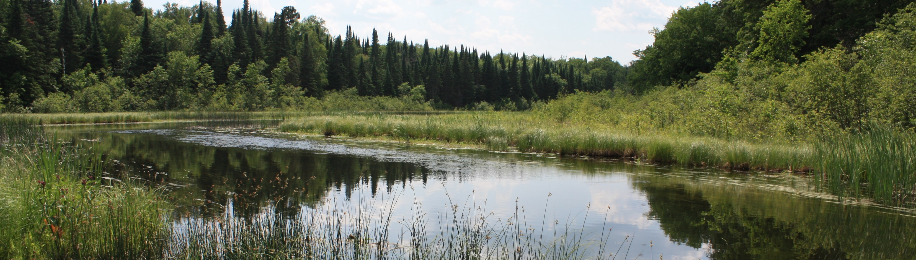


A Forest Landscape Approach to Water Quality
Rainy-Lake of the Woods Watershed
Ask an Expert Seminar Series
August 19, 2020

Slide 2
Outline
Topics:
5 Key Concepts – connecting forests and water quality.
Landowner outreach – stewardship plan posters.
Implementing forestland protection.
Questions & answers, discussion.

Slide 3
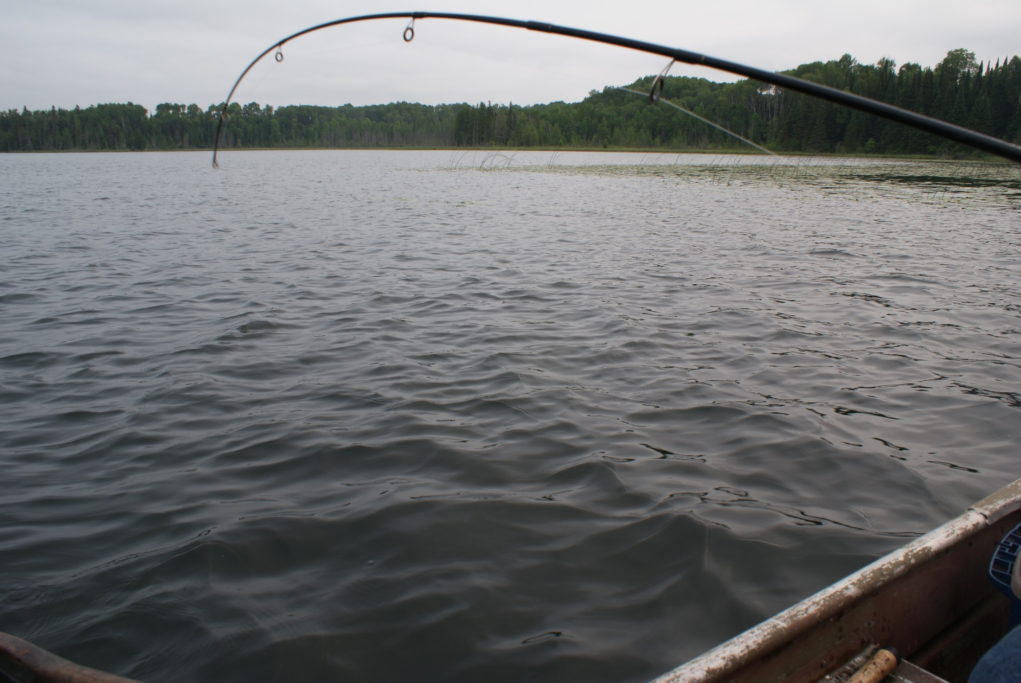
Fish on!
Quality fishing and forest land cover go together.
Forests are key to a strong tourist economy.
Forests do not get the credit they deserve!

Slide 4
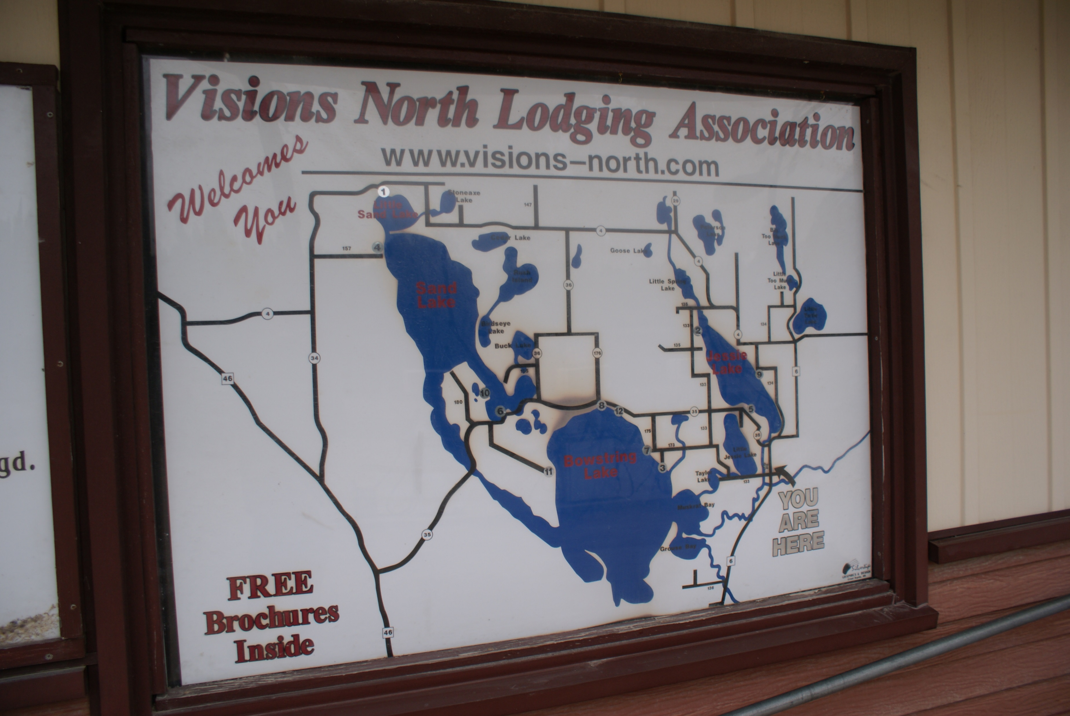

Slide 5
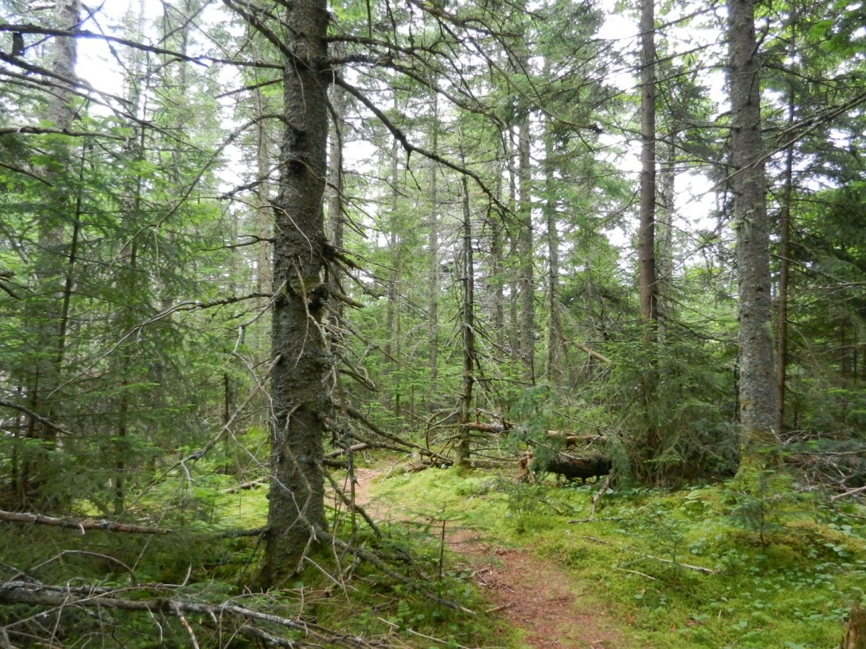
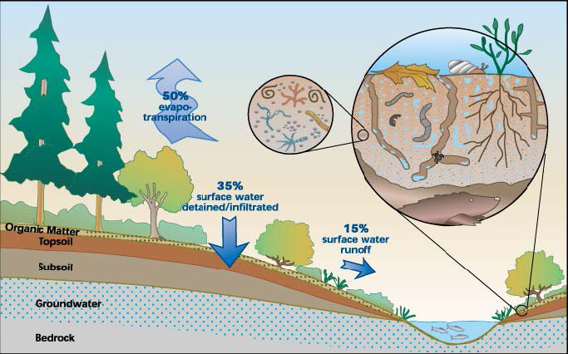
Protect the sponge!
Forests Infiltrate Water

Slide 6
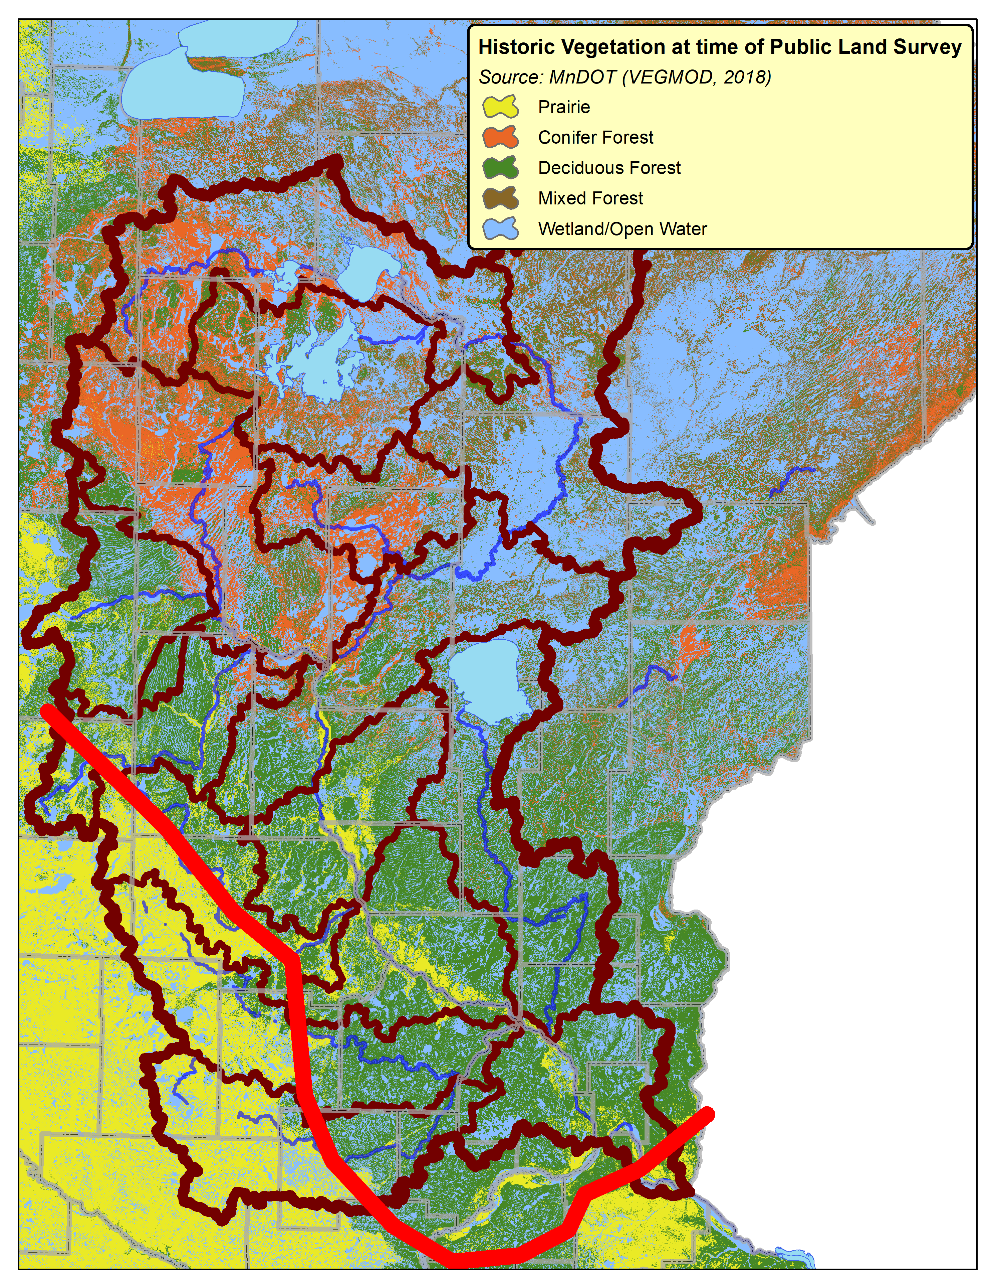
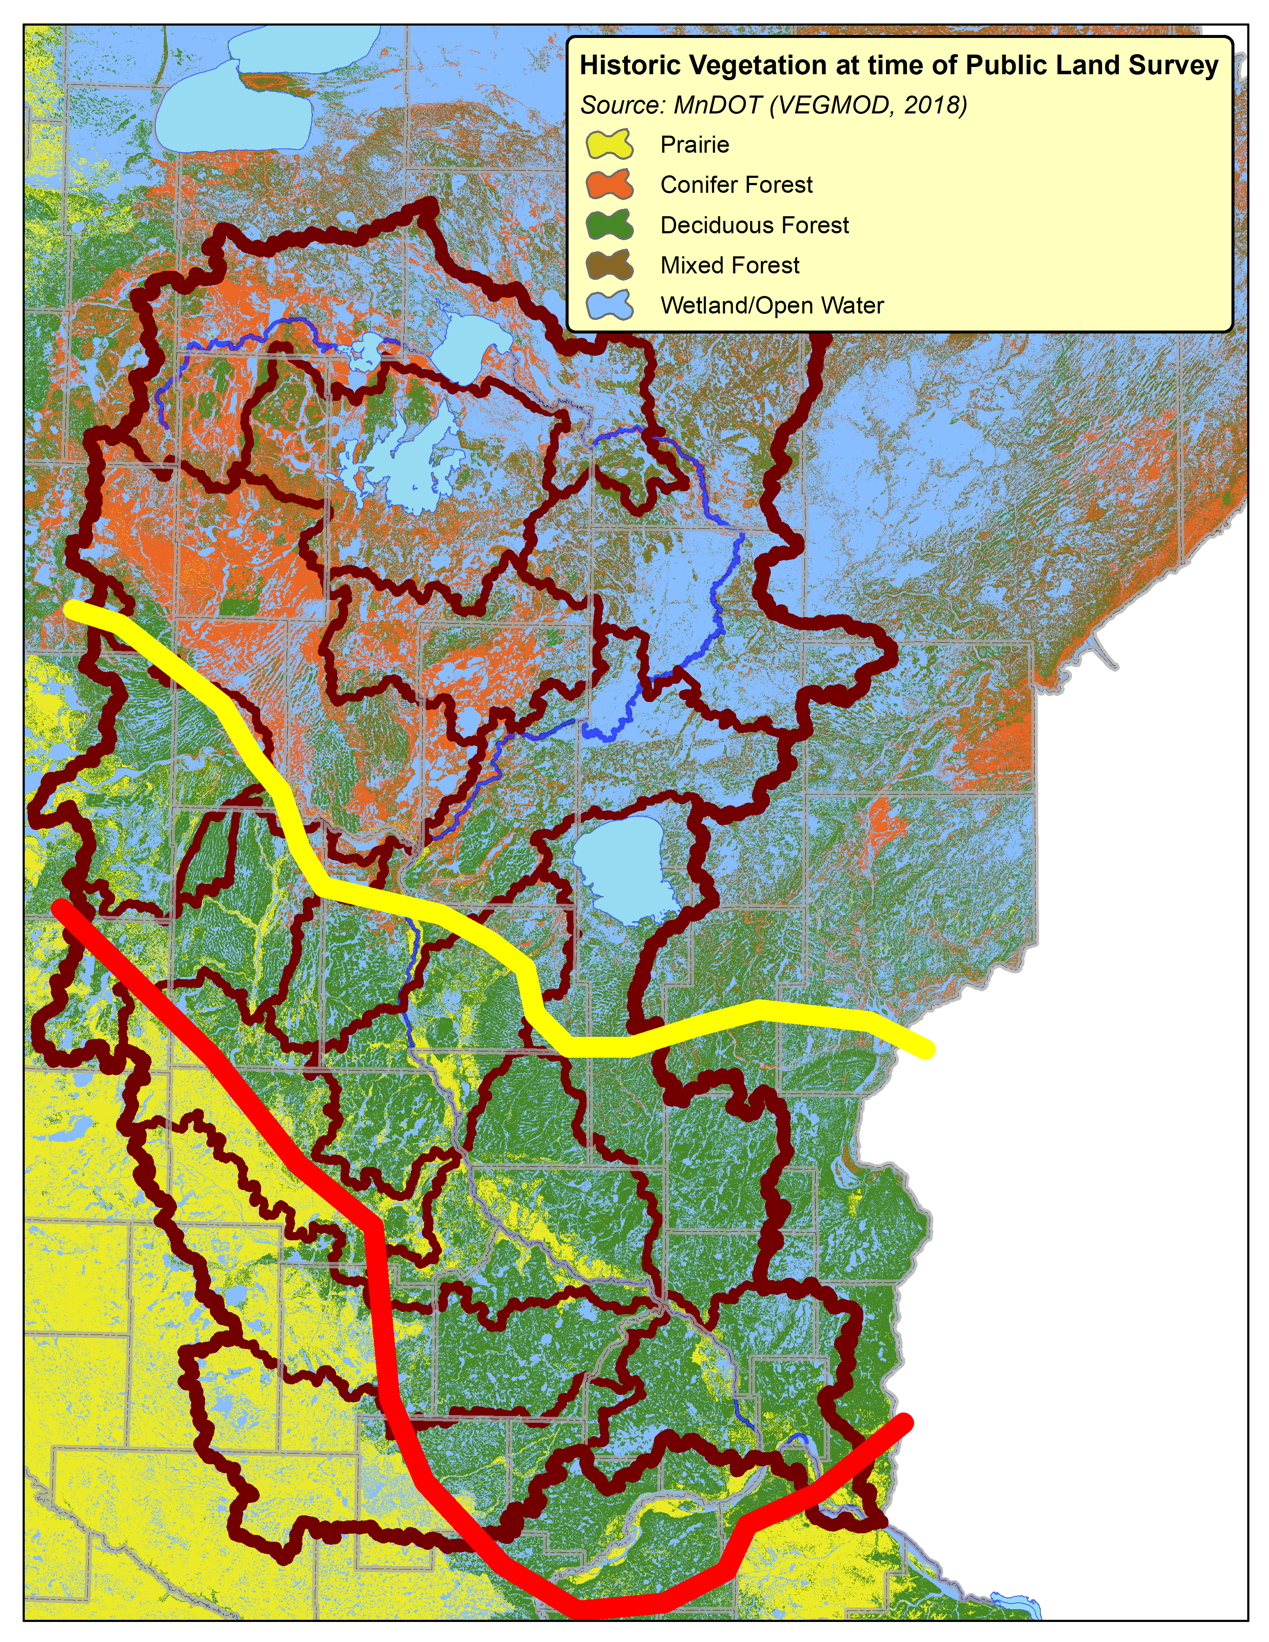
Historical Loss of Forestland
Current Forested Zone
Historical Forested Zone
Forest Loss

Slide 7
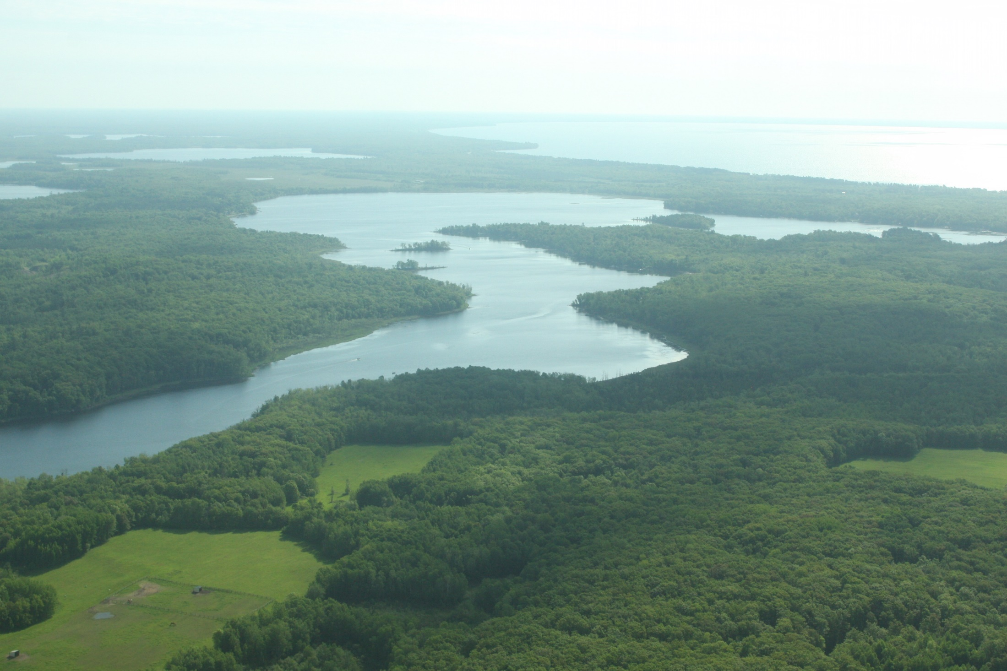
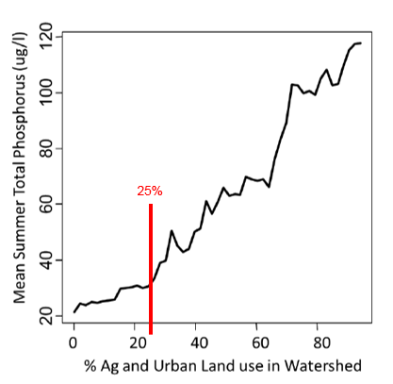
Phosphorus Increases as Forest Cover Decreases

Slide 8
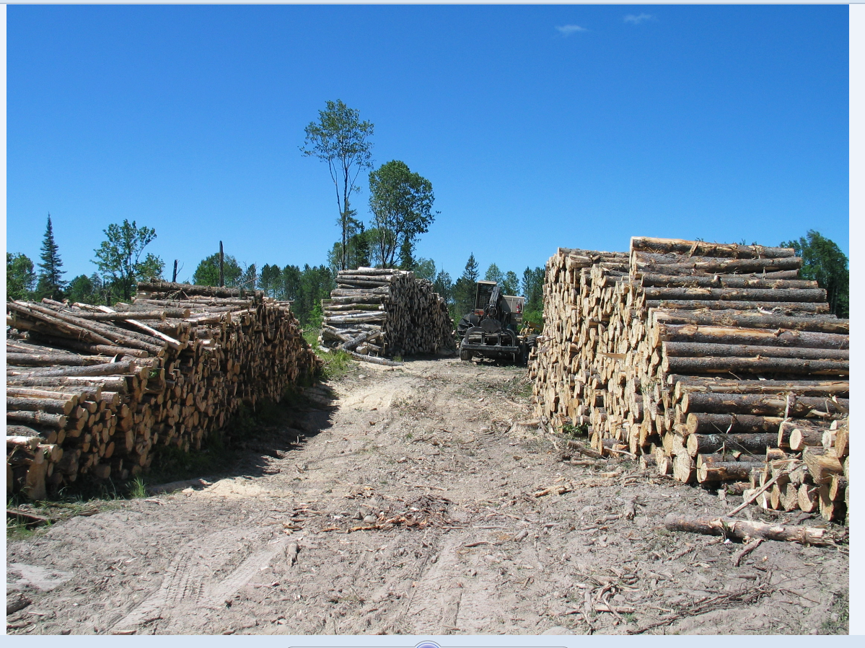
Protection doesn’t mean you can’t manage!
Working Lands

Slide 9
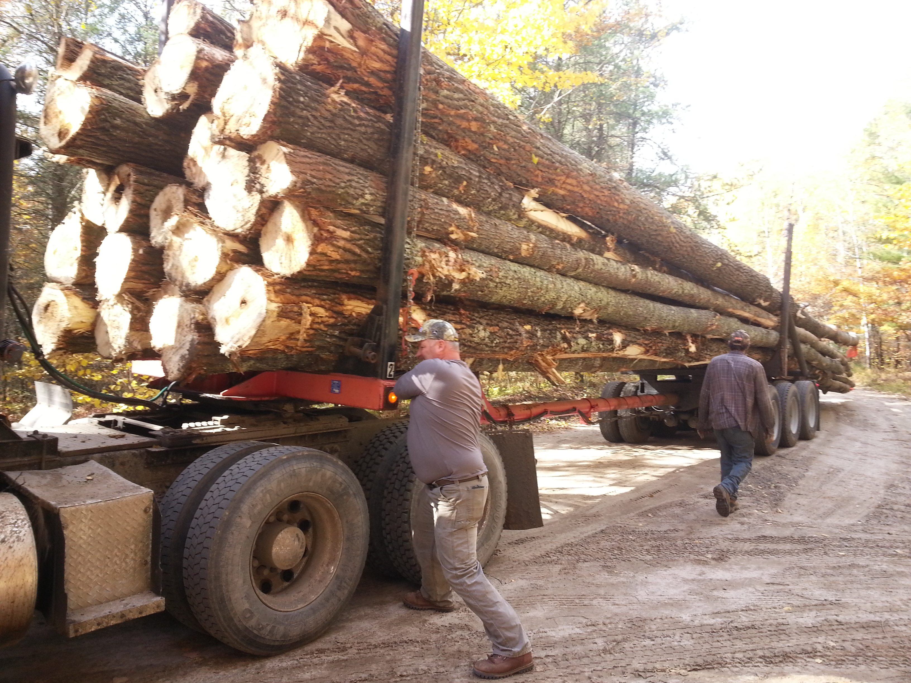
NW Itasca County Big Tooth Aspen

Slide 10

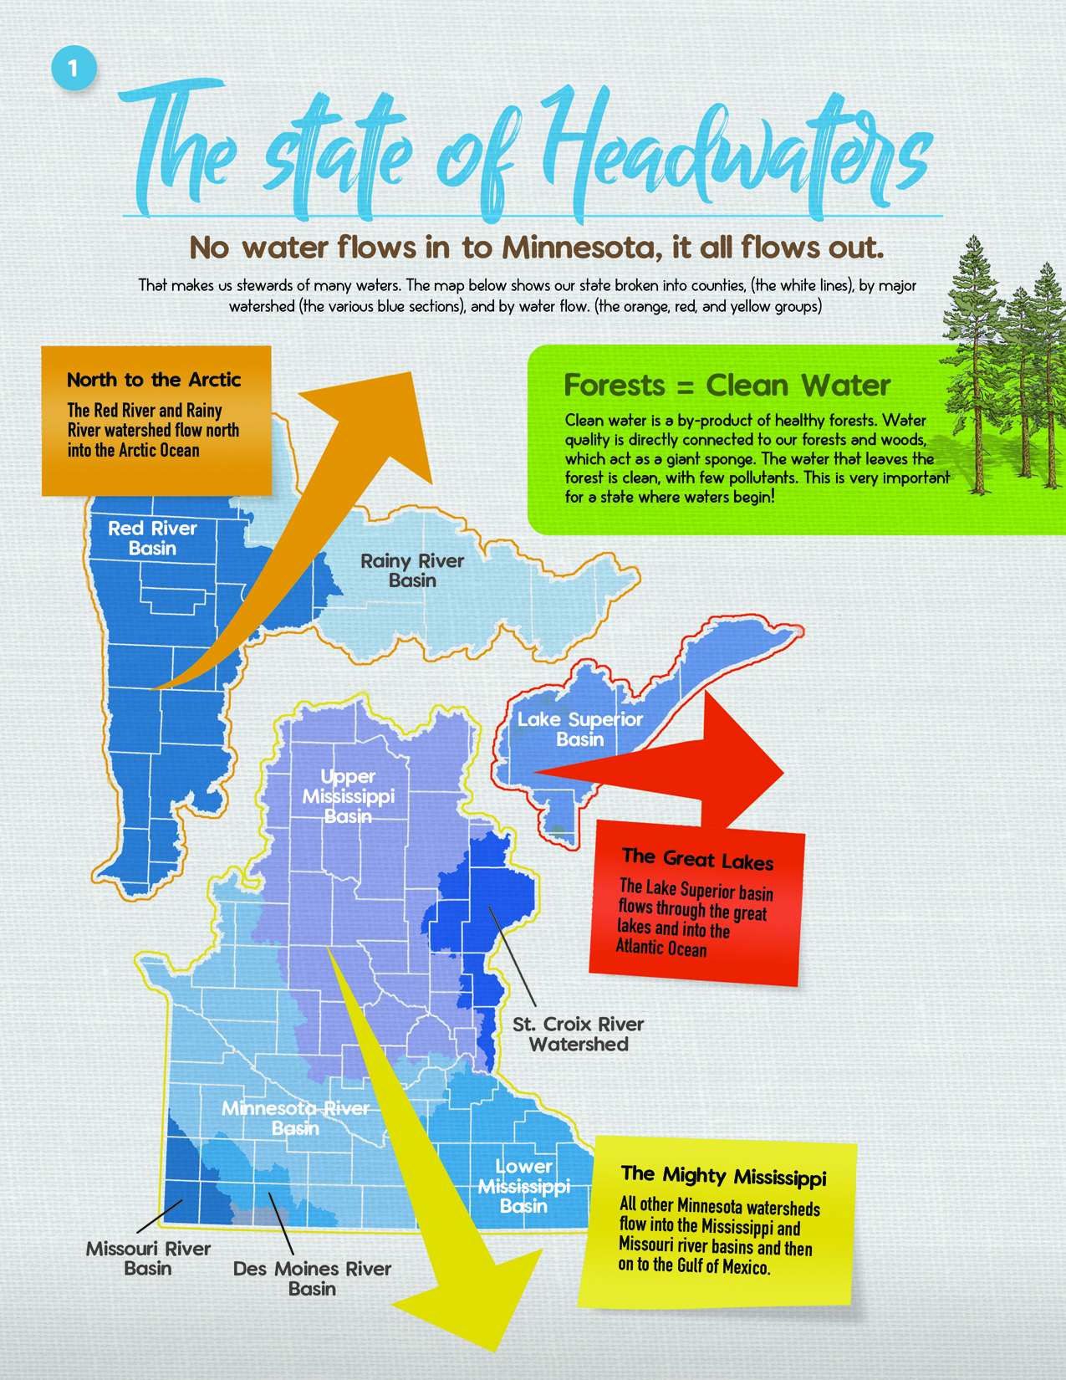
Inserts - Making the Forest Cover /
Water Quality Connection

Slide 11
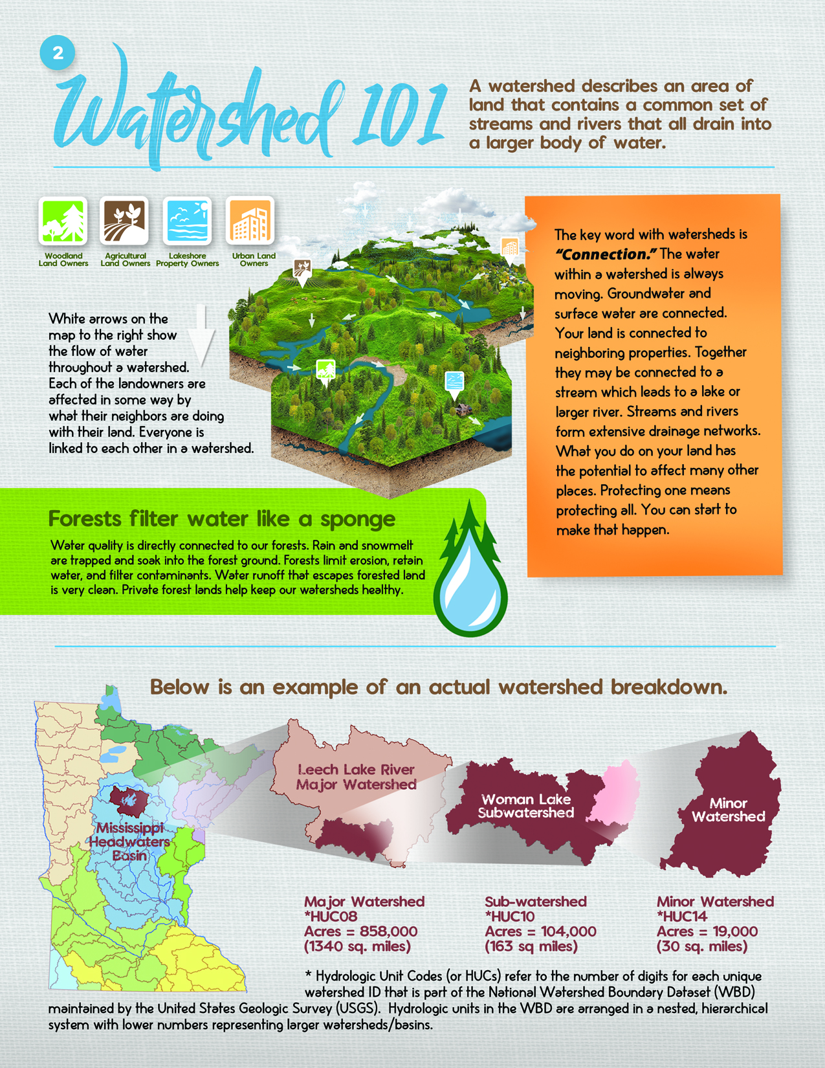
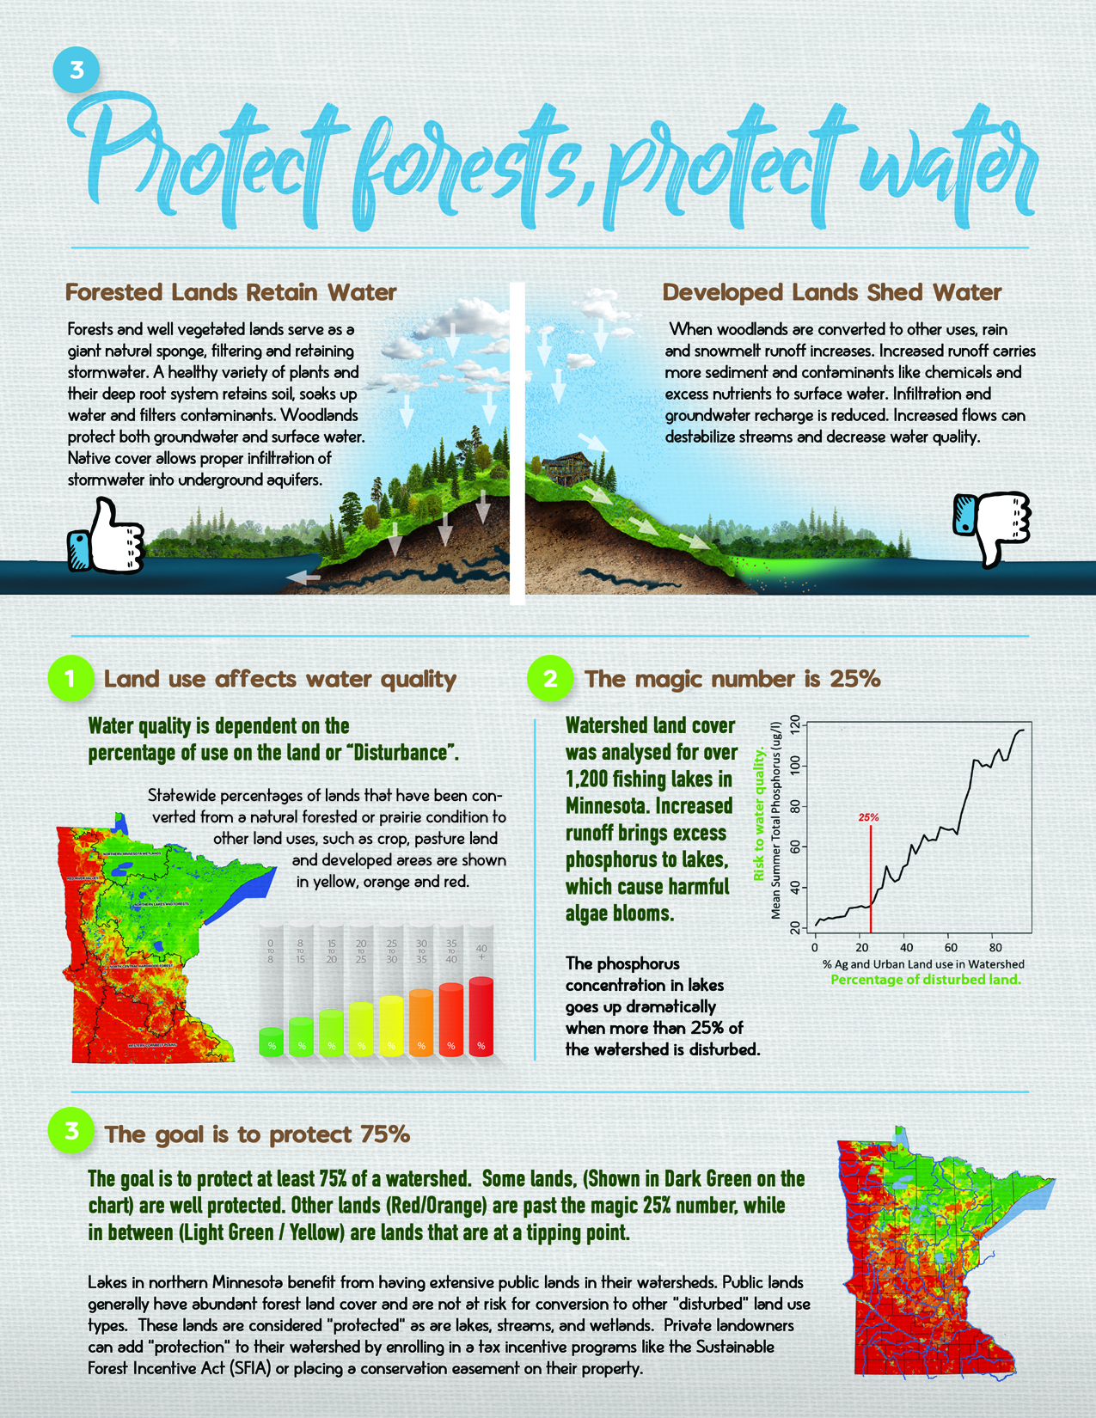
Inserts continued

Slide 12
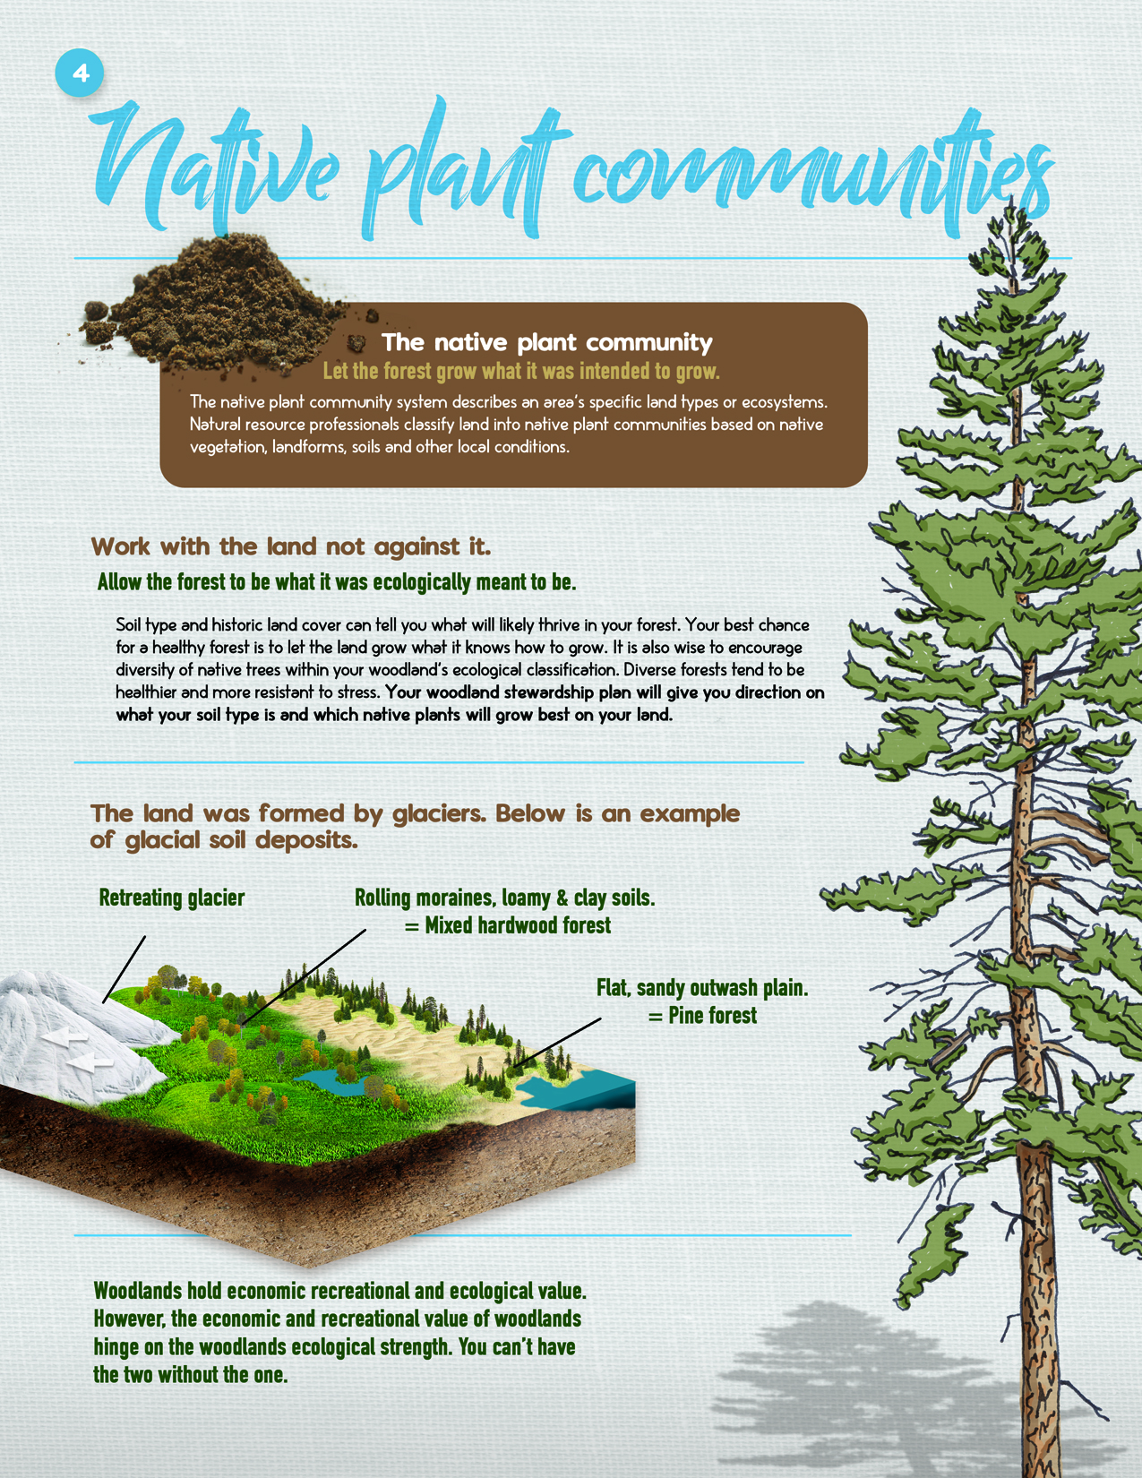
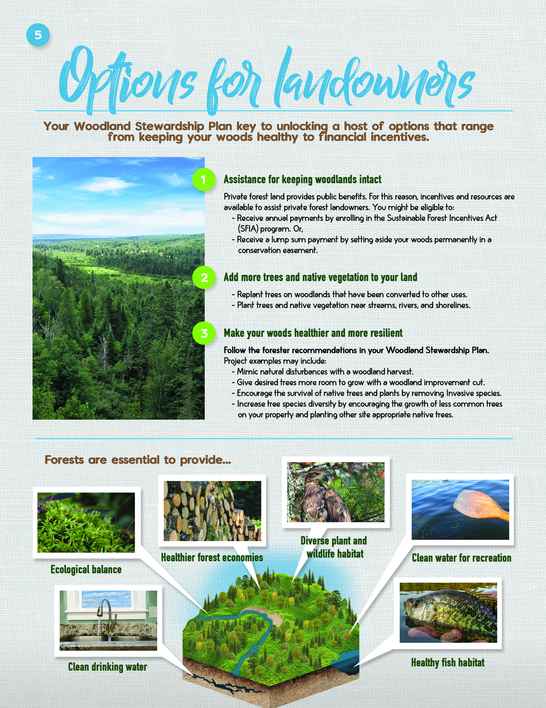
Inserts continued

Slide 13

Diversity is a big part of forest resilience.

Slide 14
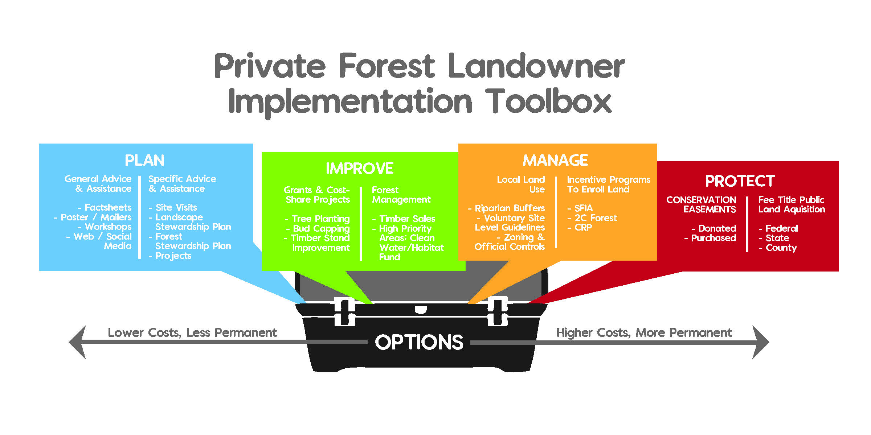
PFM Implementation Toolbox
PTM
TM
Landowners choose!
Source: Dan Steward, BWSR. Referenced in the USFS publication, “Landscape Stewardship Guide”.

Slide 15
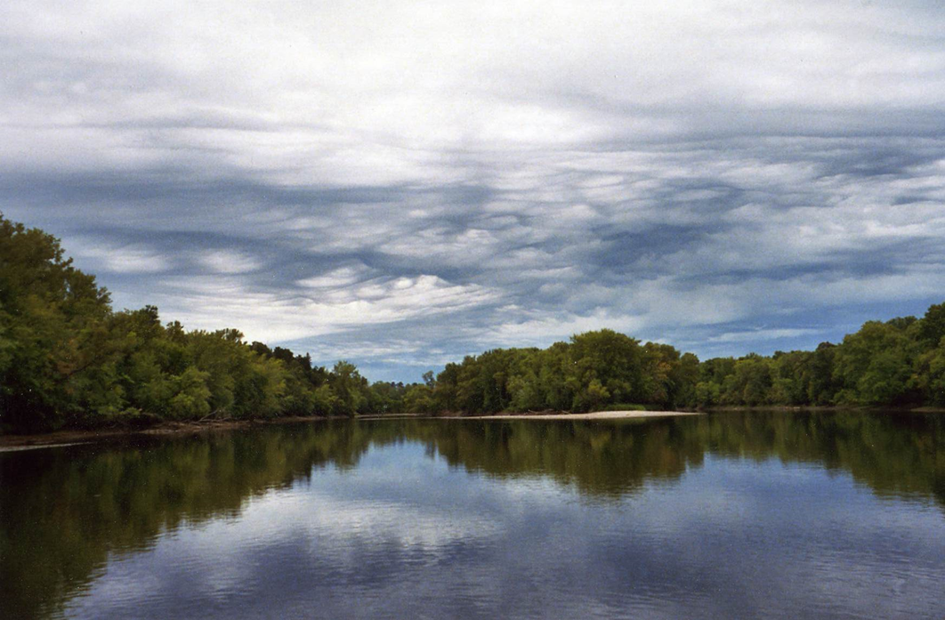
Prioritize, Target, Measure (PTM)
New Legislative Directive: PTM
  Prioritize (by WATER)
    Minor Watersheds (HUC14s) with Important Lakes / River Stretches
  Target (by LAND)
    Private Forest Lands
    Acreage Threshold (>20 acres)
    Tool = RAQ
  Measure (by NEEDLE)
    Move the Needle toward Protection!
Notes:
We can drill down to the individual landowner and pull relevant property information (from the County assessor’s office)

Slide 16
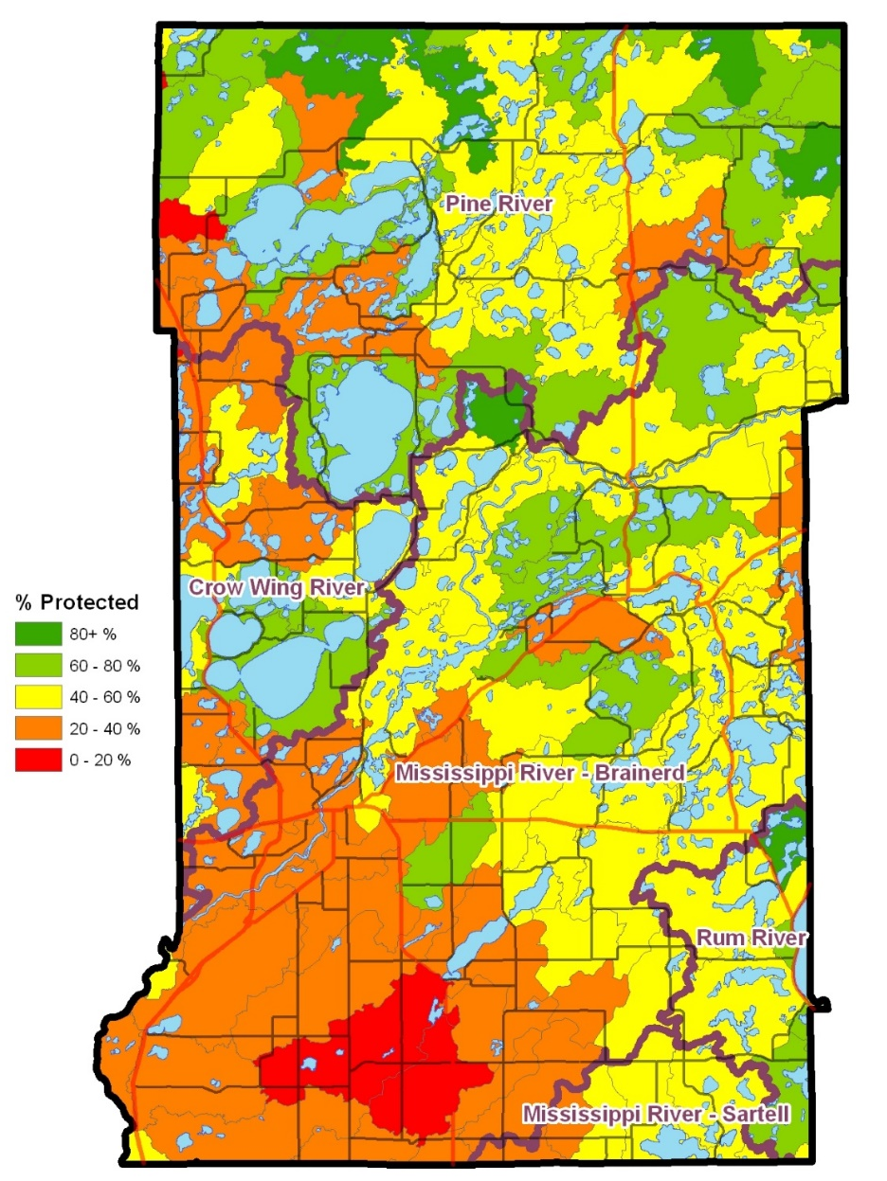
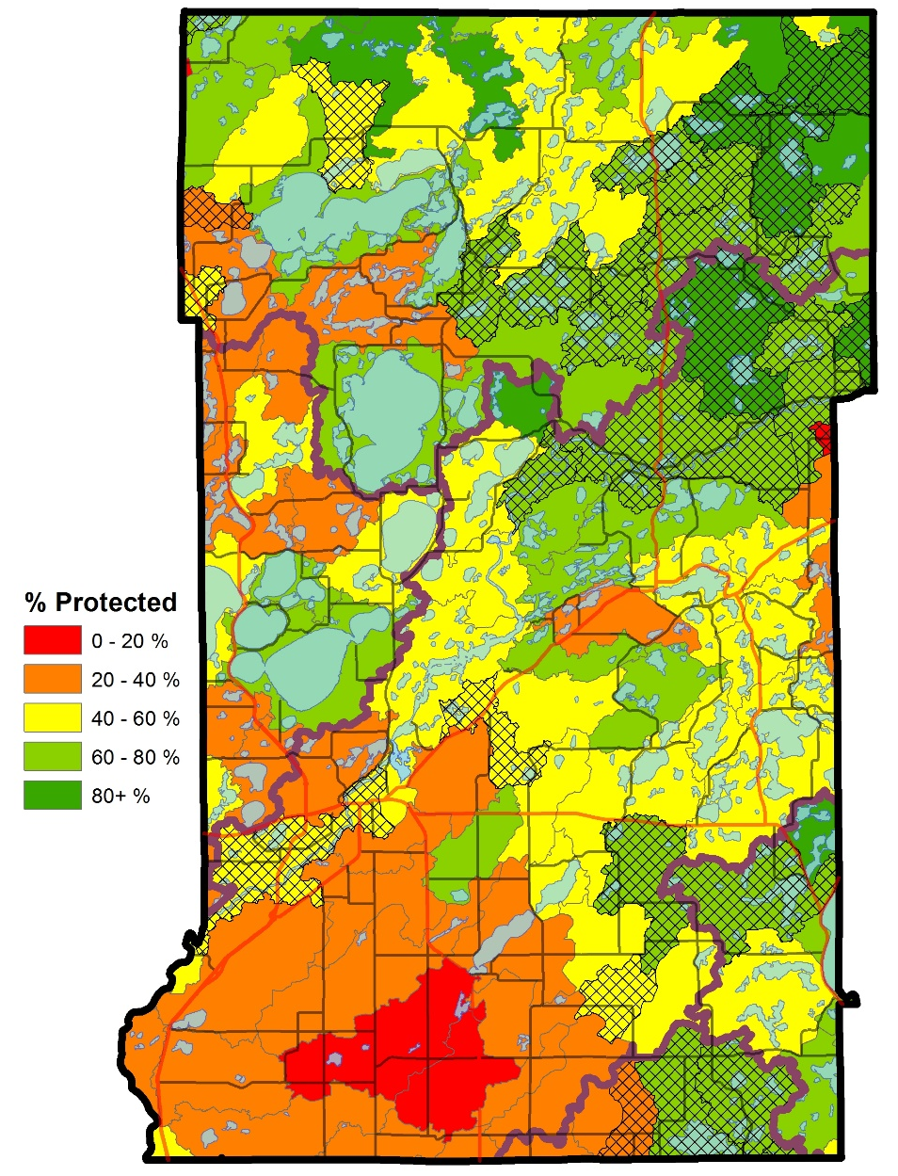
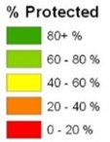
SFIA – A Key Partner in Water Resource Protection
Before SFIA
After SFIA
Currently a state general fund program, SFIA needs your support…

Slide 17
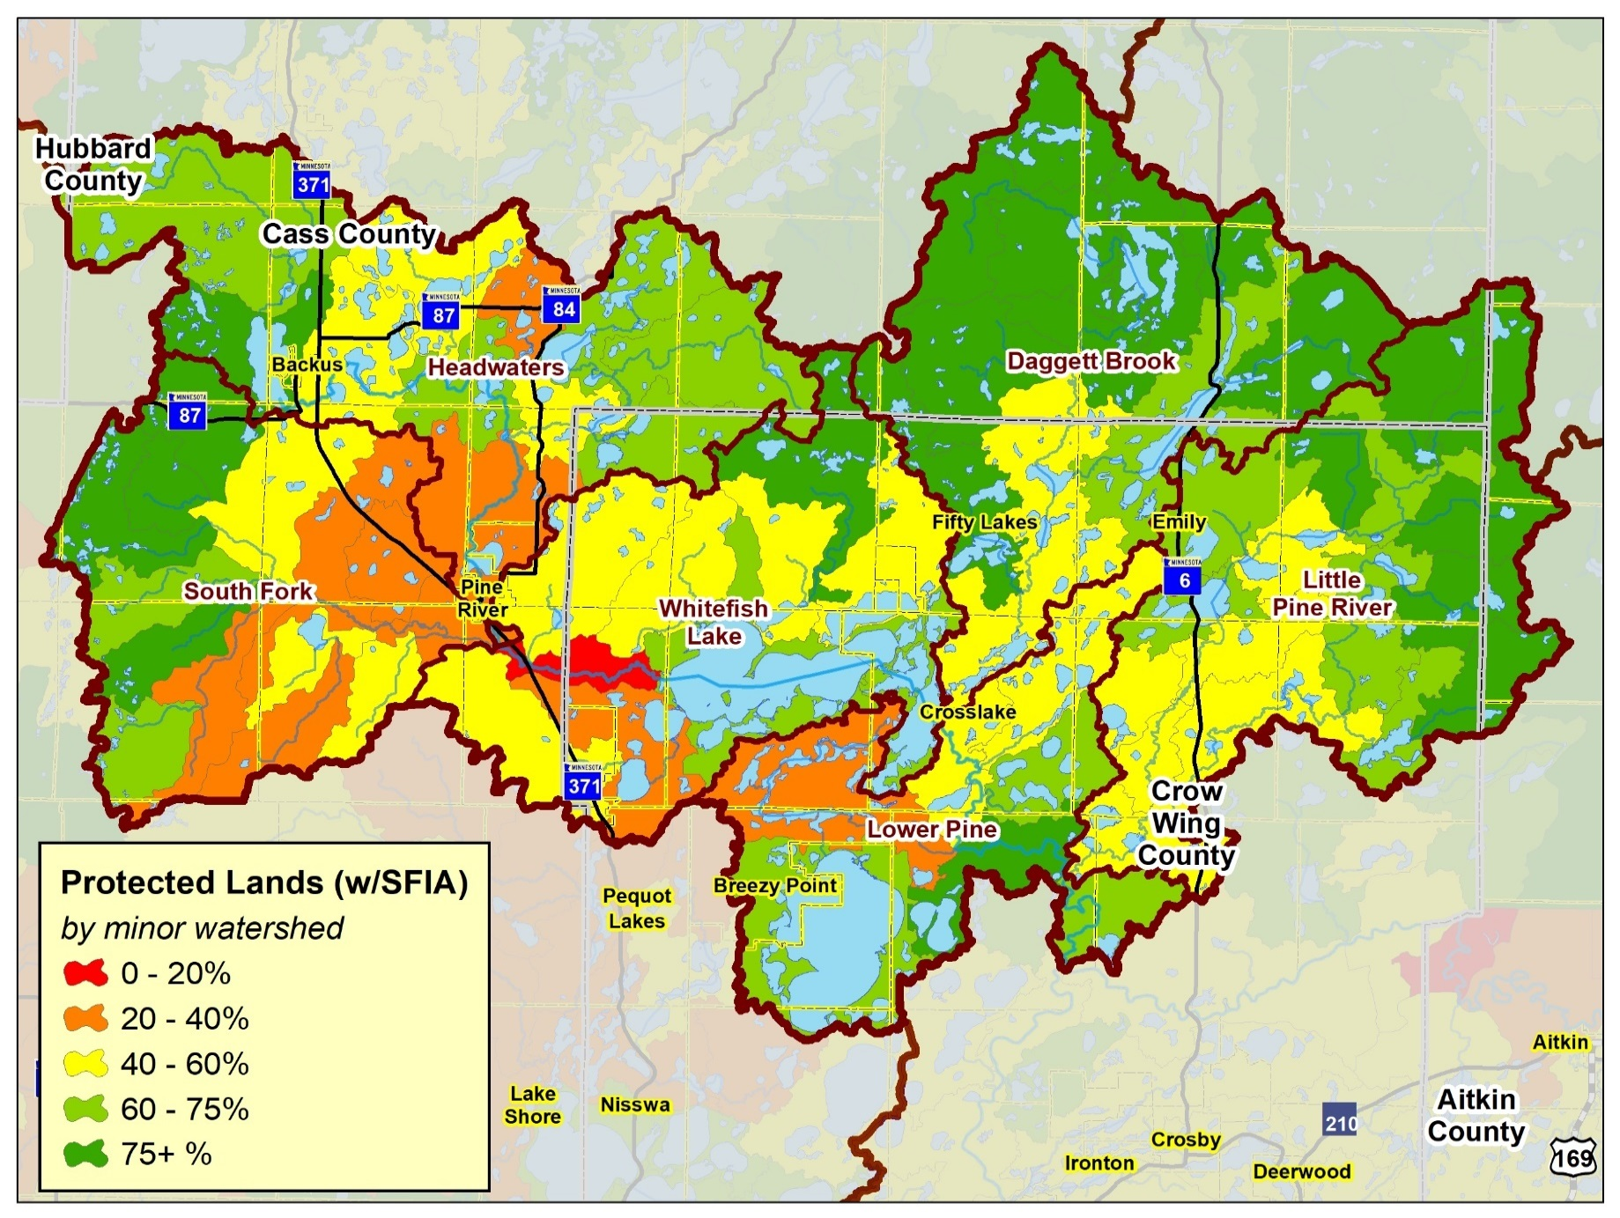
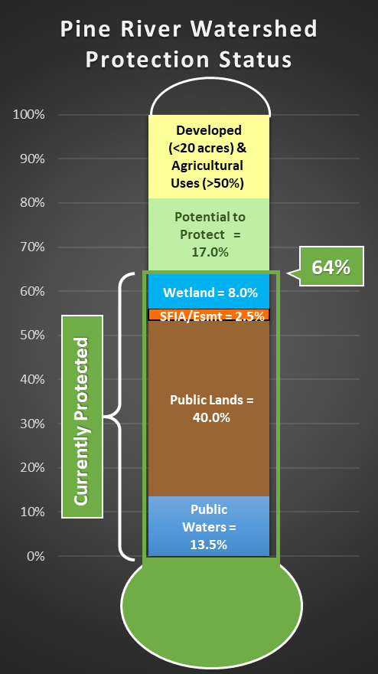
    Protected Lands:
    Public Lands/Waters, Easements, Private Wetlands, SFIA
60%
77%
53%
57%
71%
56%

Slide 18
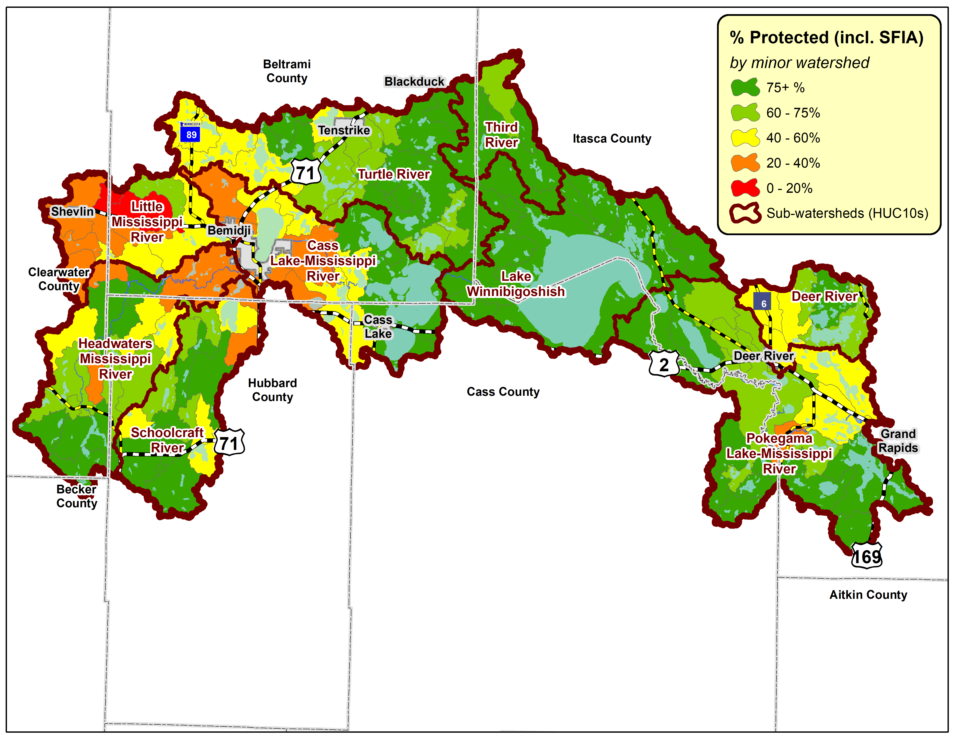
Protected Lands

Slide 19
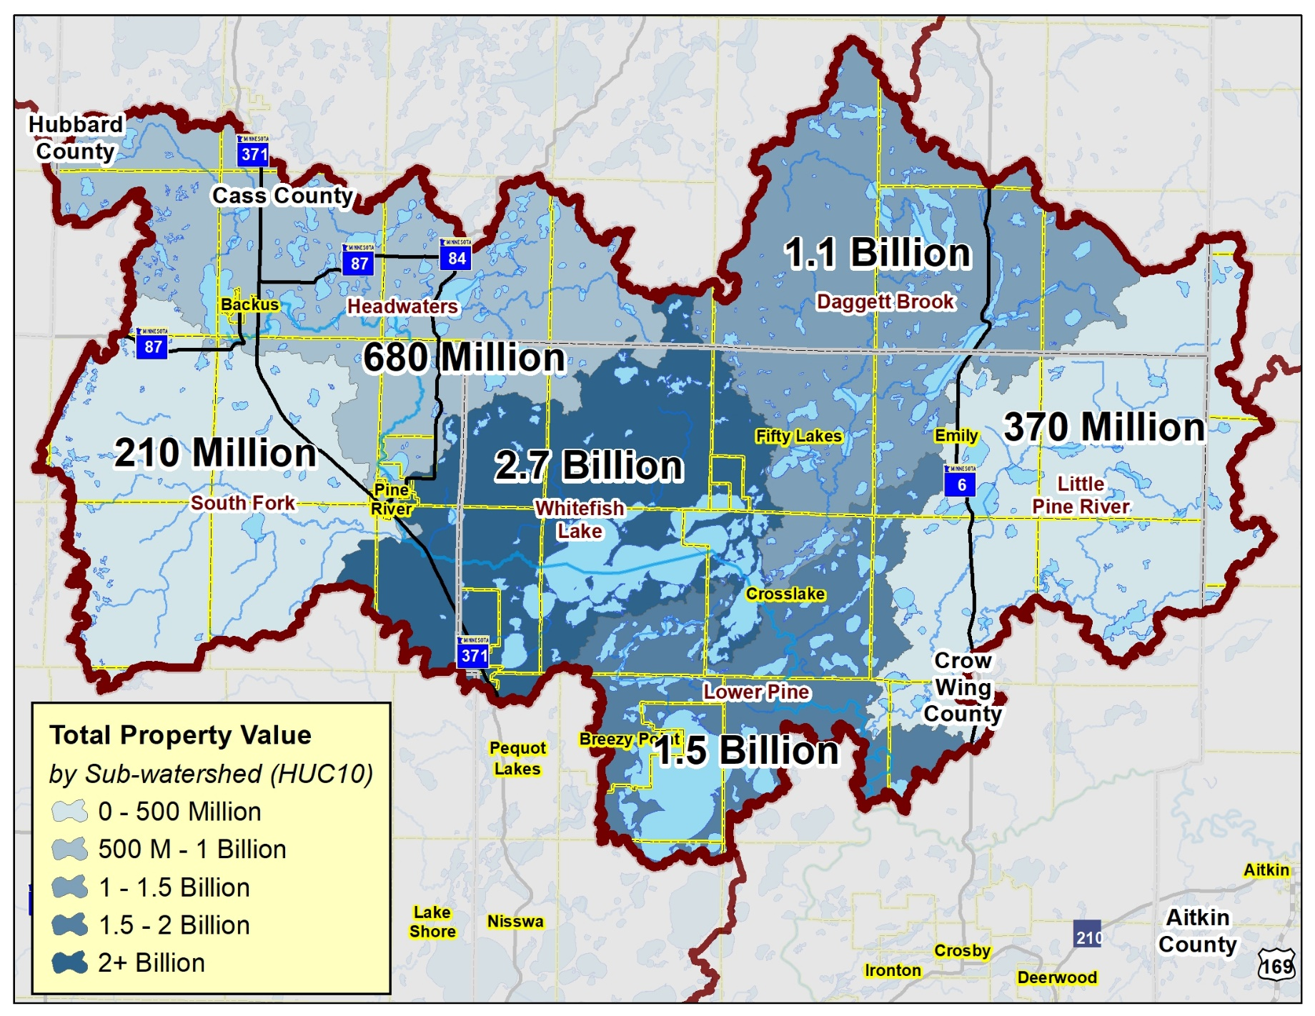
    Property Value varies greatly by watershed:
    Total Property Values (Land + Building)

Slide 20
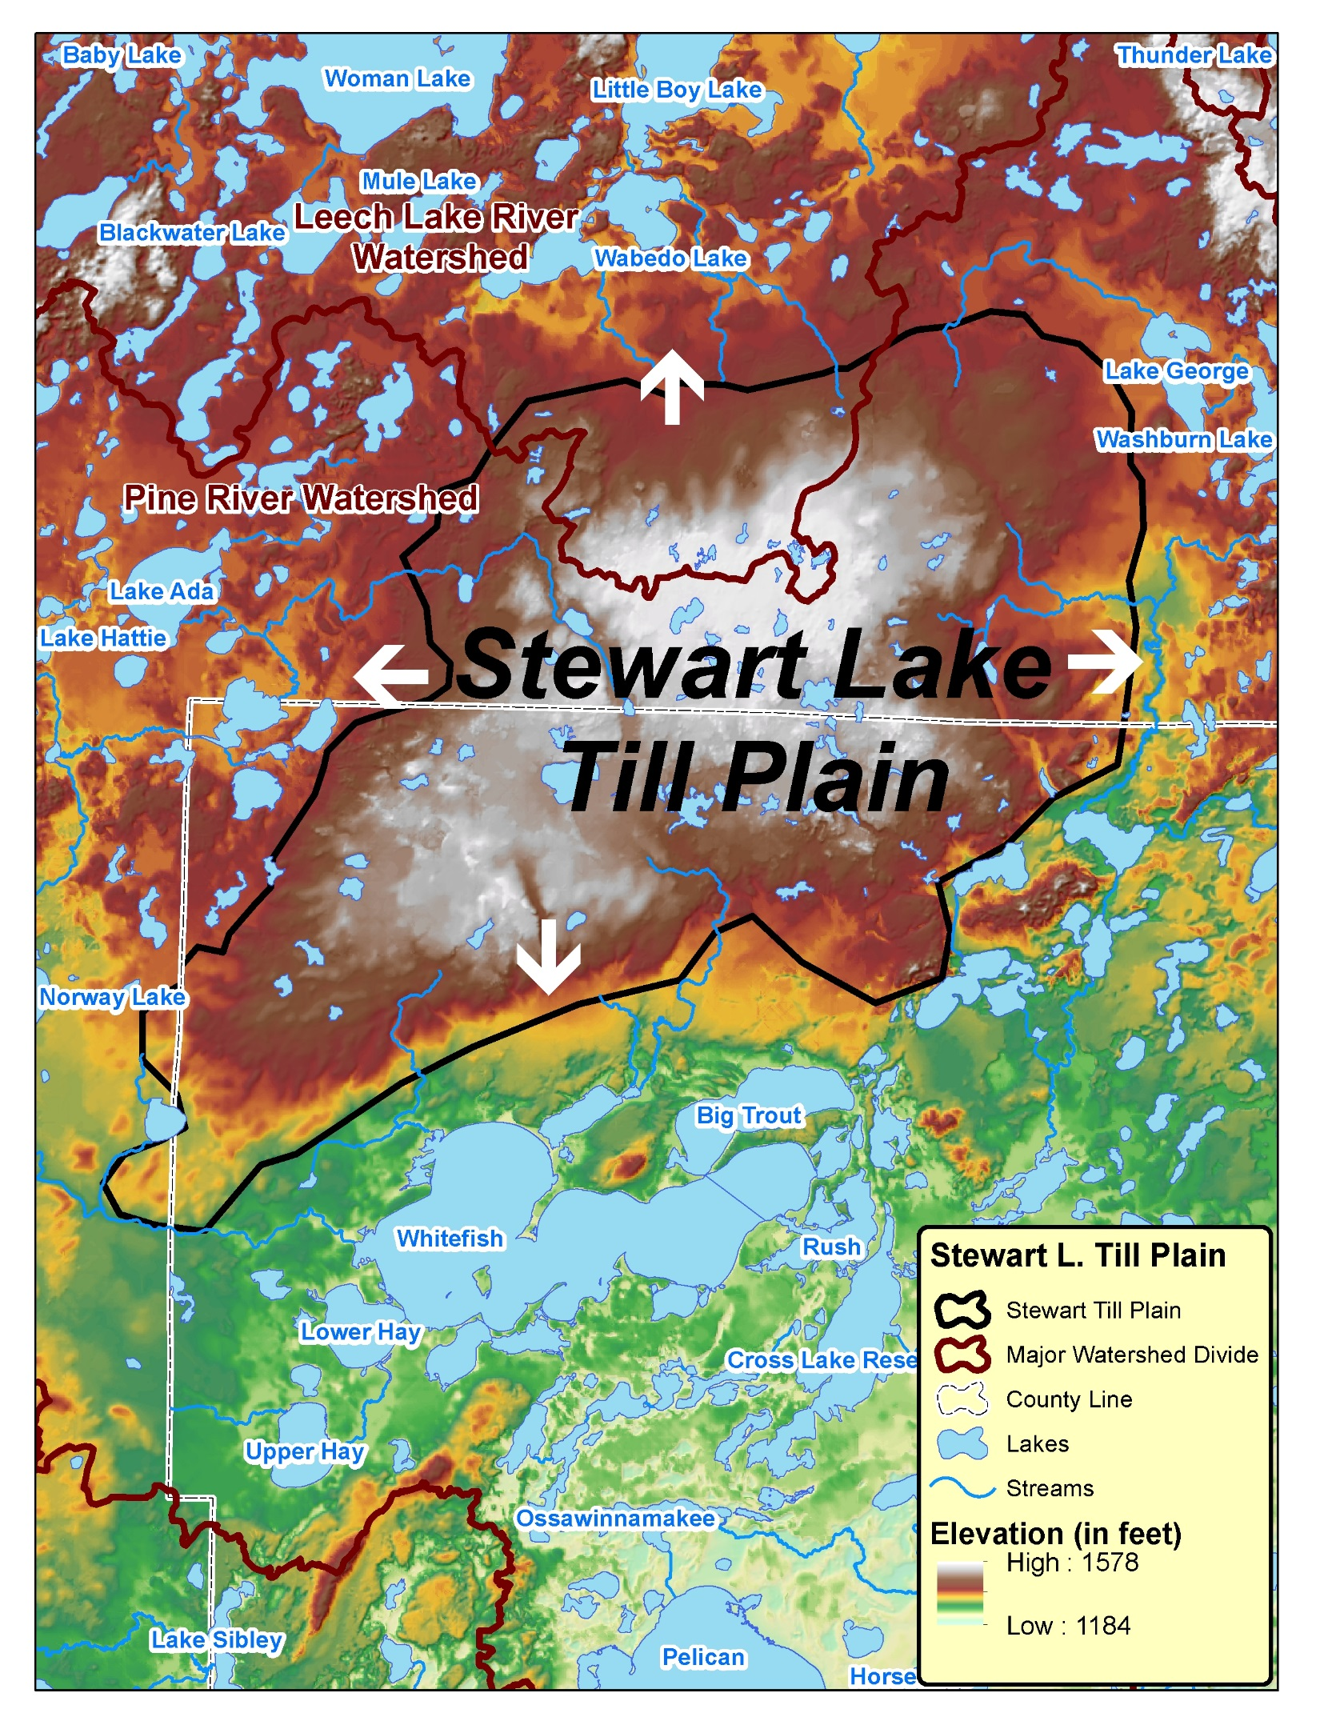
It all starts with geomorphology

Slide 21
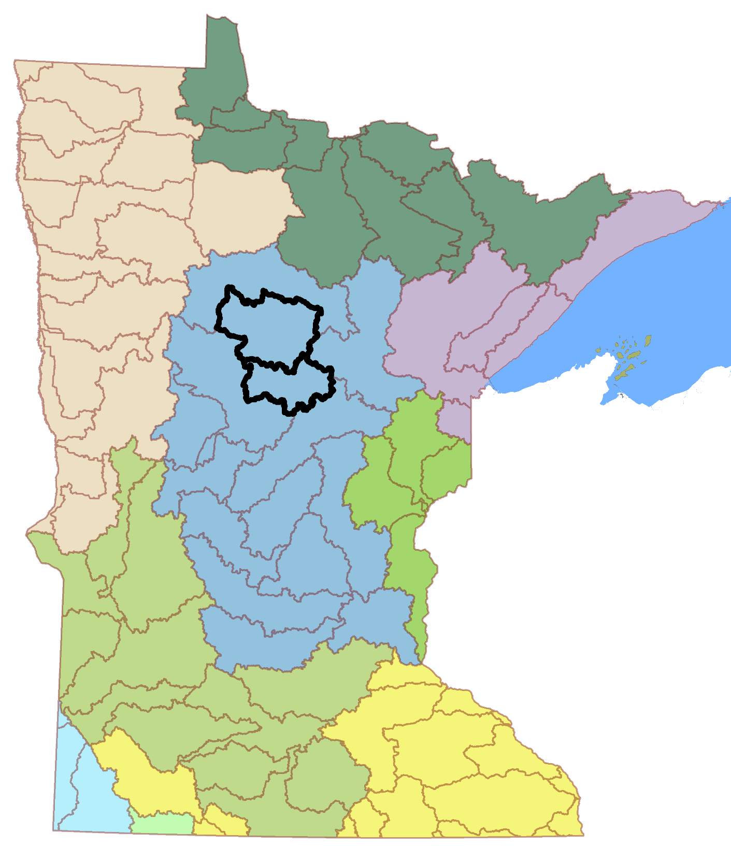
Flow Matters
Geography
“Water, in all its uses and permutations, is by far the most valuable commodity that comes from the forest land that we manage, assist others to manage, and/or regulate.”
National Association of State Foresters
HUC 3 Level:
Upper Miss Basin
HUC 8 Level:
Leech Lake Major WD
Pine River Major WD
HUC 10 Level:
Subwatersheds
HUC 14 Level:
Minor watersheds
St. Cloud
Parcel Level:
Landowners
Twin Cities
PTM Delivery Path
Notes:
Forests play a critical role in keeping water clean by absorbing and filtering water, preventing erosion through soil stabilization, and allowing for groundwater recharge.
The National Association of State Foresters recognized the connection of healthy forests to clean water with its policy statement: “Water, in all its uses and permutations, is by far the most valuable commodity that comes from the forest land that we manage, assist others to manage, and/or regulate.”
Understanding how our watersheds and landscapes work in MN is critical. Very diverse state, very complex state.
Not all basins are created and function alike. We depend on each basin differently.

Slide 22
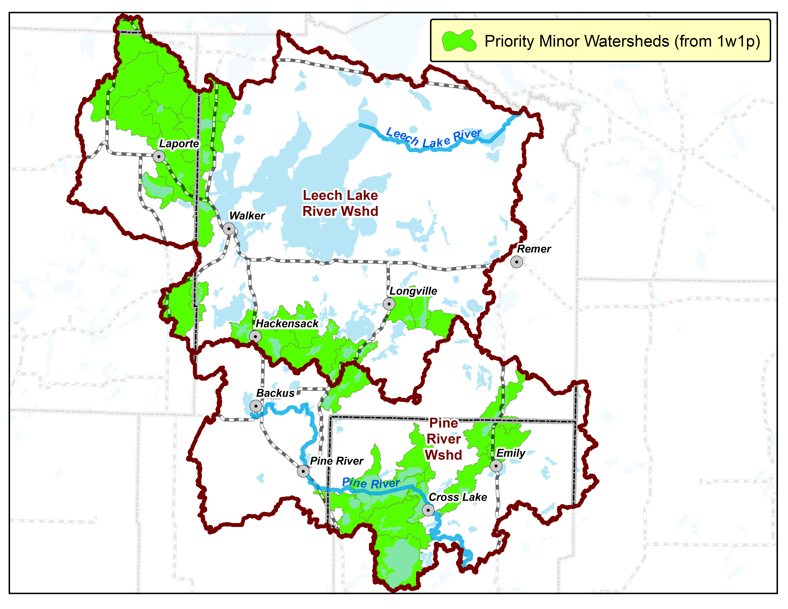
First prioritize minor watersheds

Slide 23
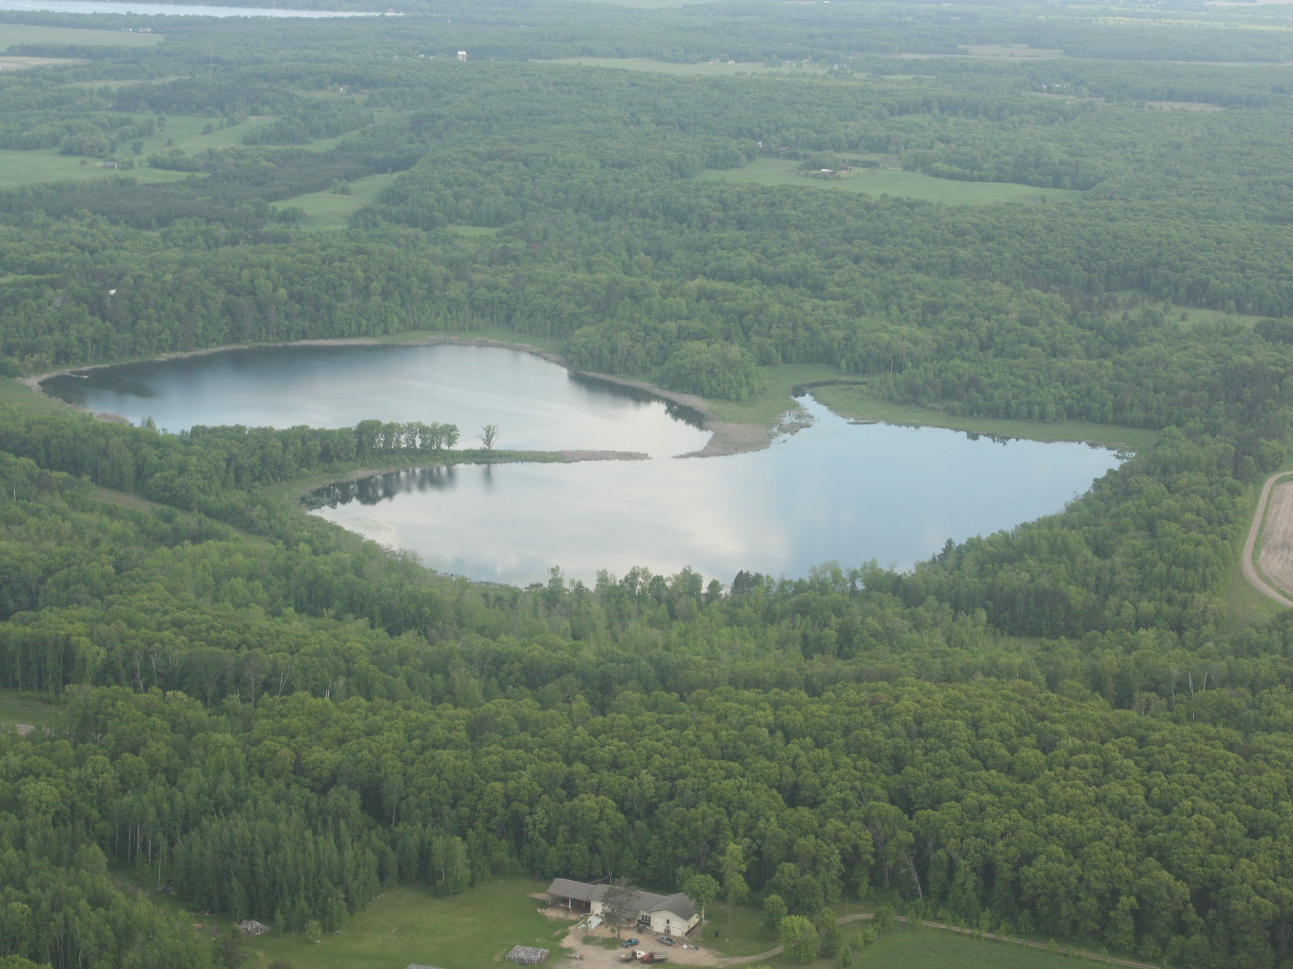
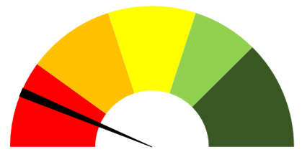
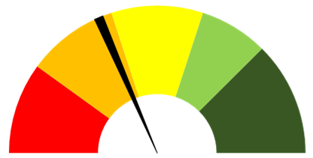
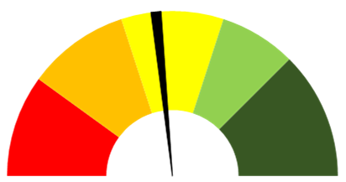
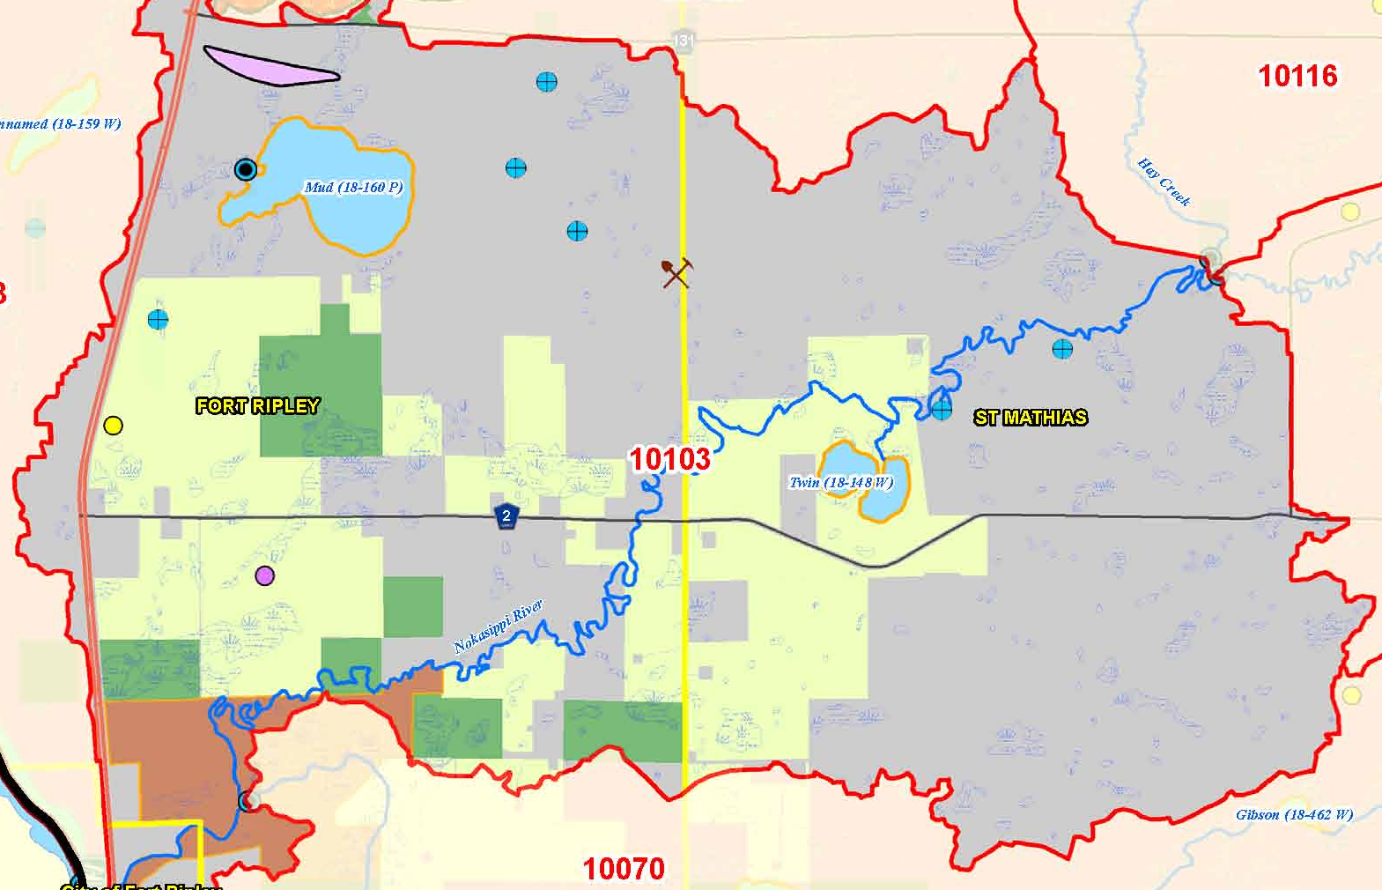
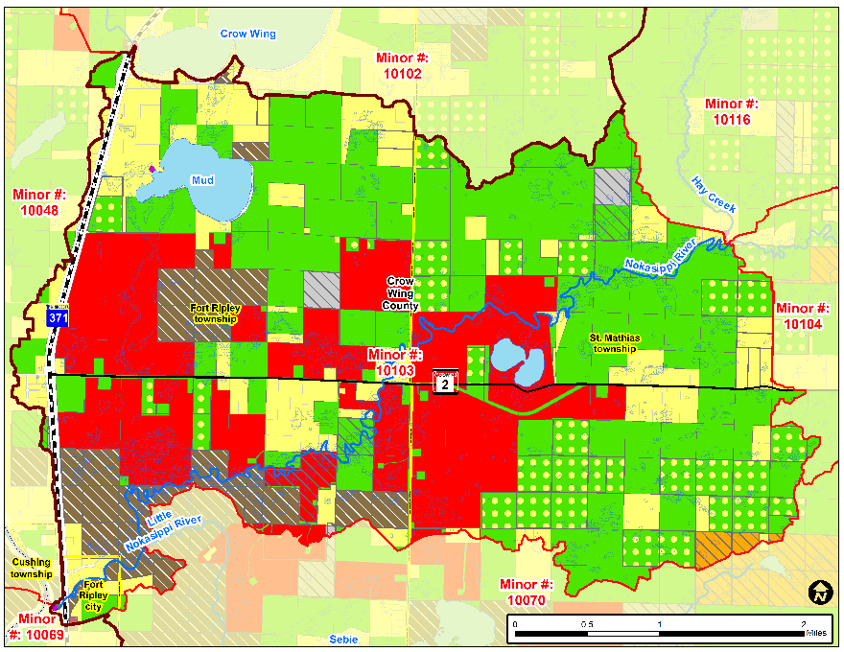
Lower Nokasippi Minor Watershed
% Public Land | 4
% Easements | 0
% Lakes | 2
% Streams | 1
% Wetlands (private) | 6
% Protected | 13
  Pre-ACUB
% Public Land | 4
% Easements | 24
% Lakes | 2
% Streams | 1
% Wetlands (private) | 6
% Protected | 37
  2014
% Public Land | 4
% Easements | 33
% Lakes | 2
% Streams | 1
% Wetlands (private) | 6
% Protected | 46
  2019

Slide 24
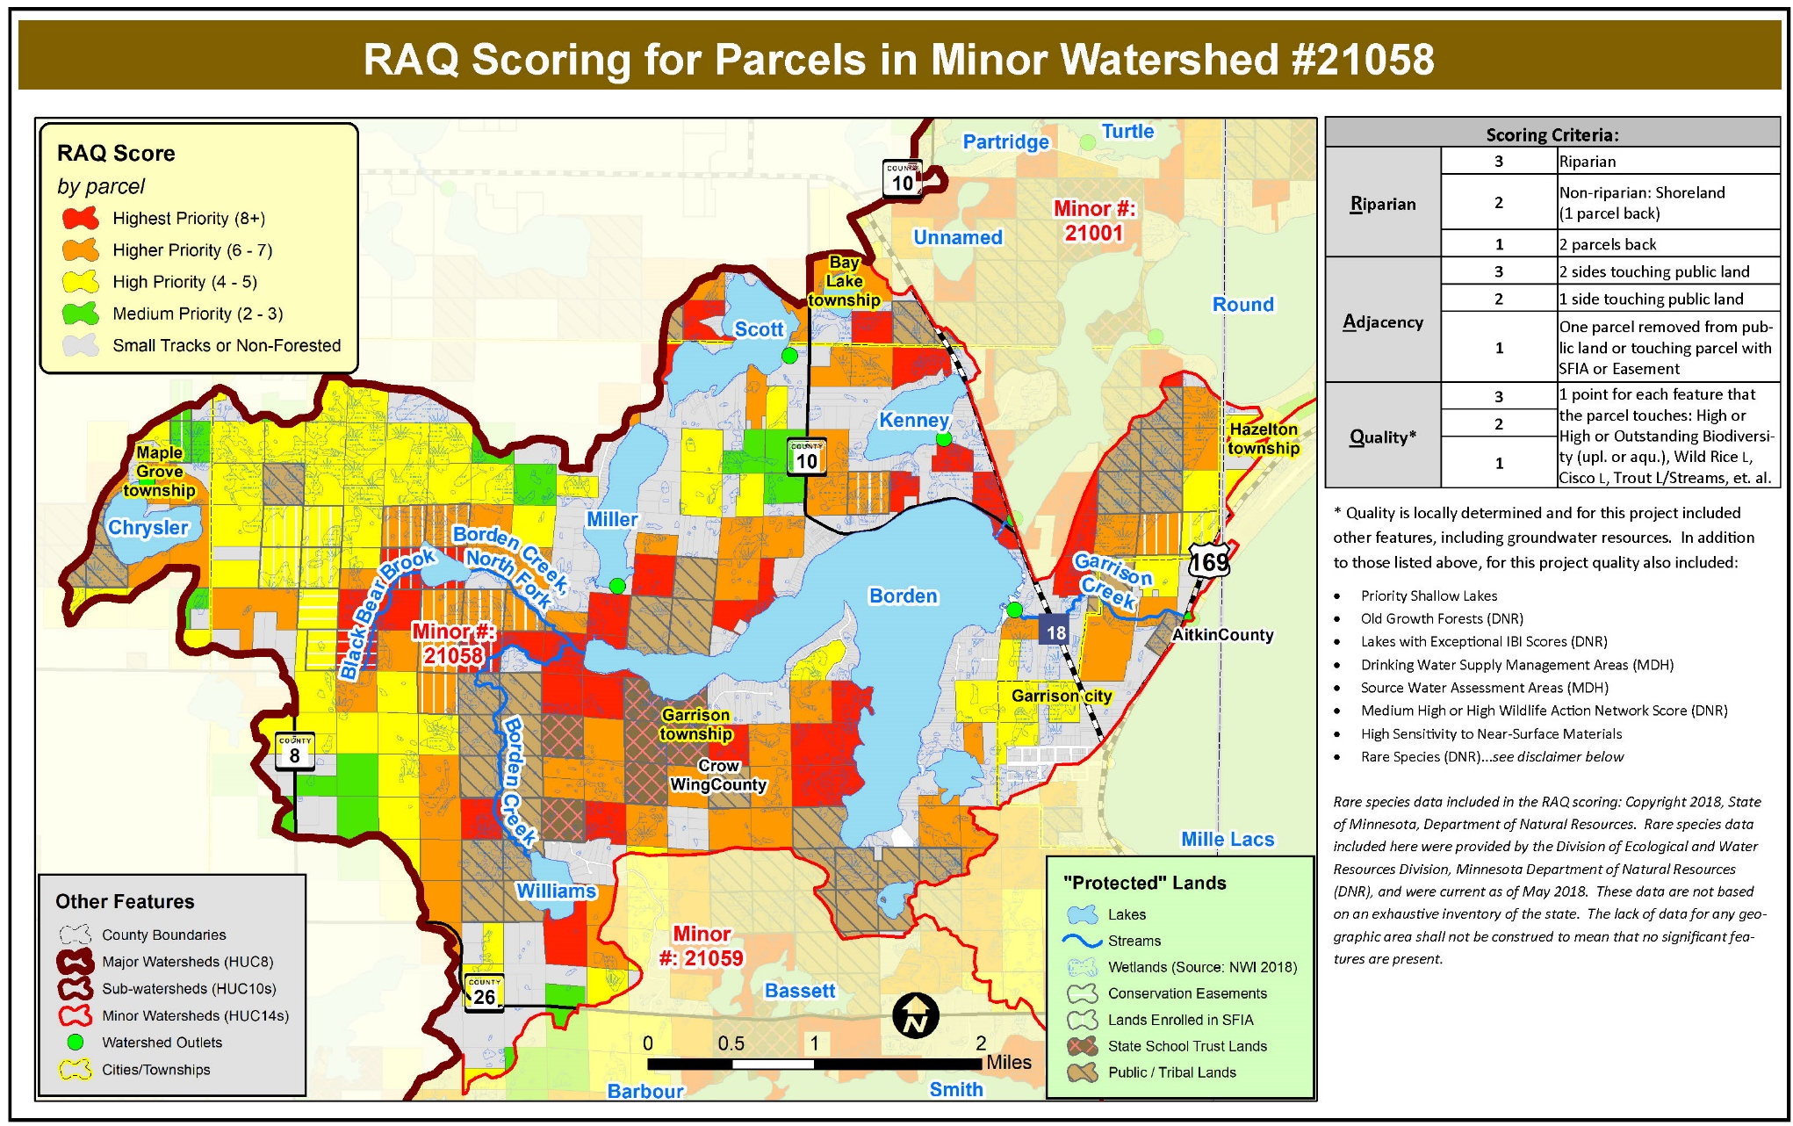
PTM – Targeting parcels

Slide 25
MN Forestland Protection Tools
2c
SFIA
Conservation easements
Fee title (public land acquisition)

Slide 26

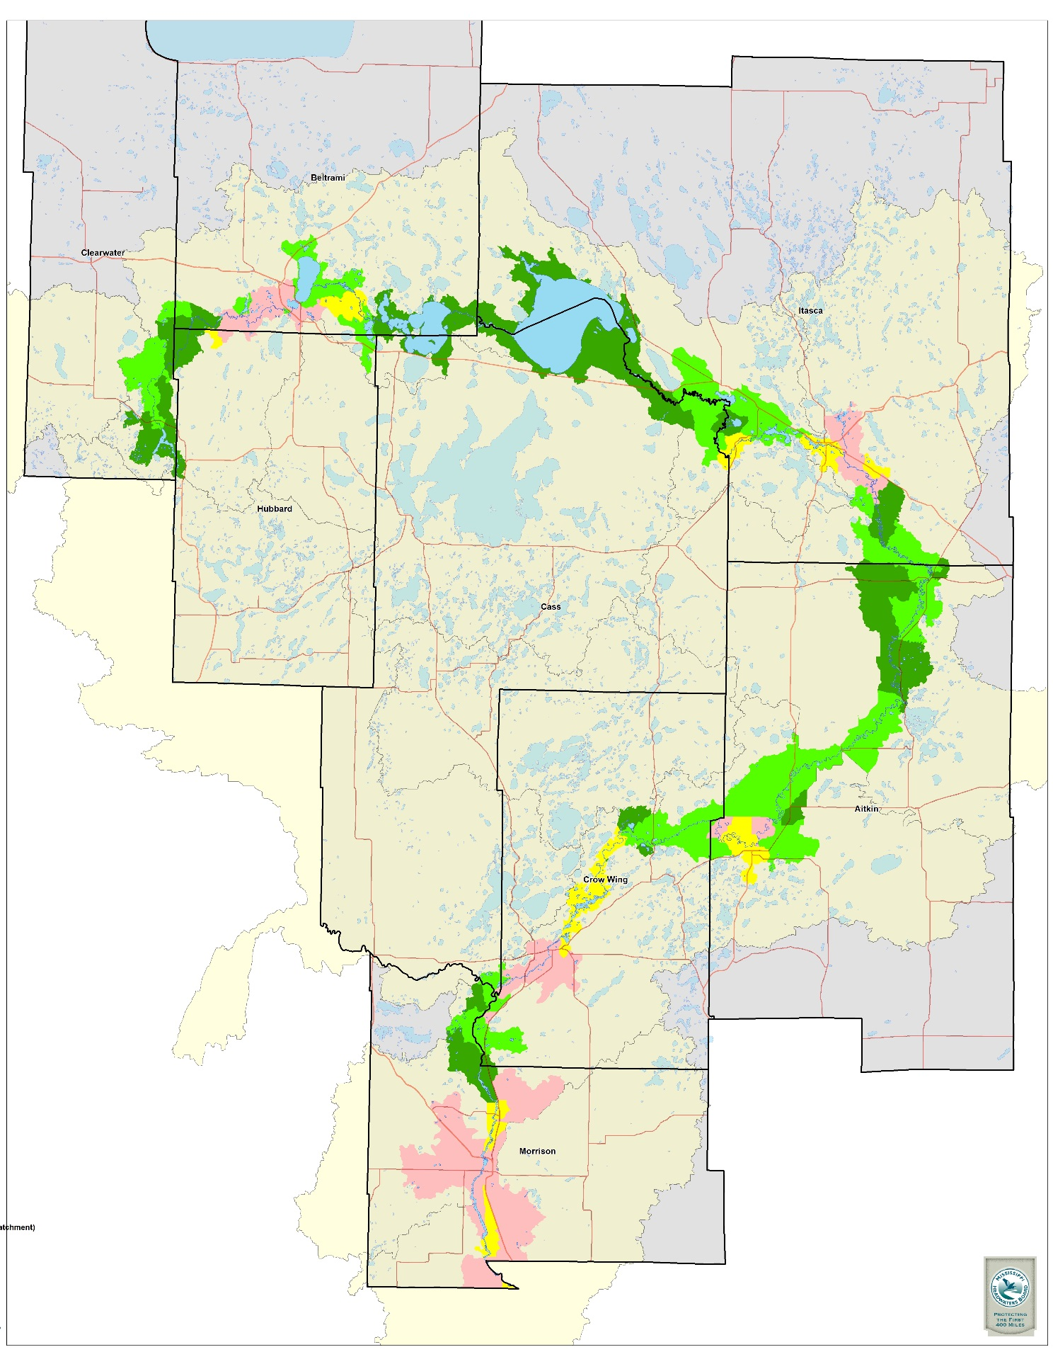
Can we still
protect
the Upper
Mississippi
River?

Slide 27
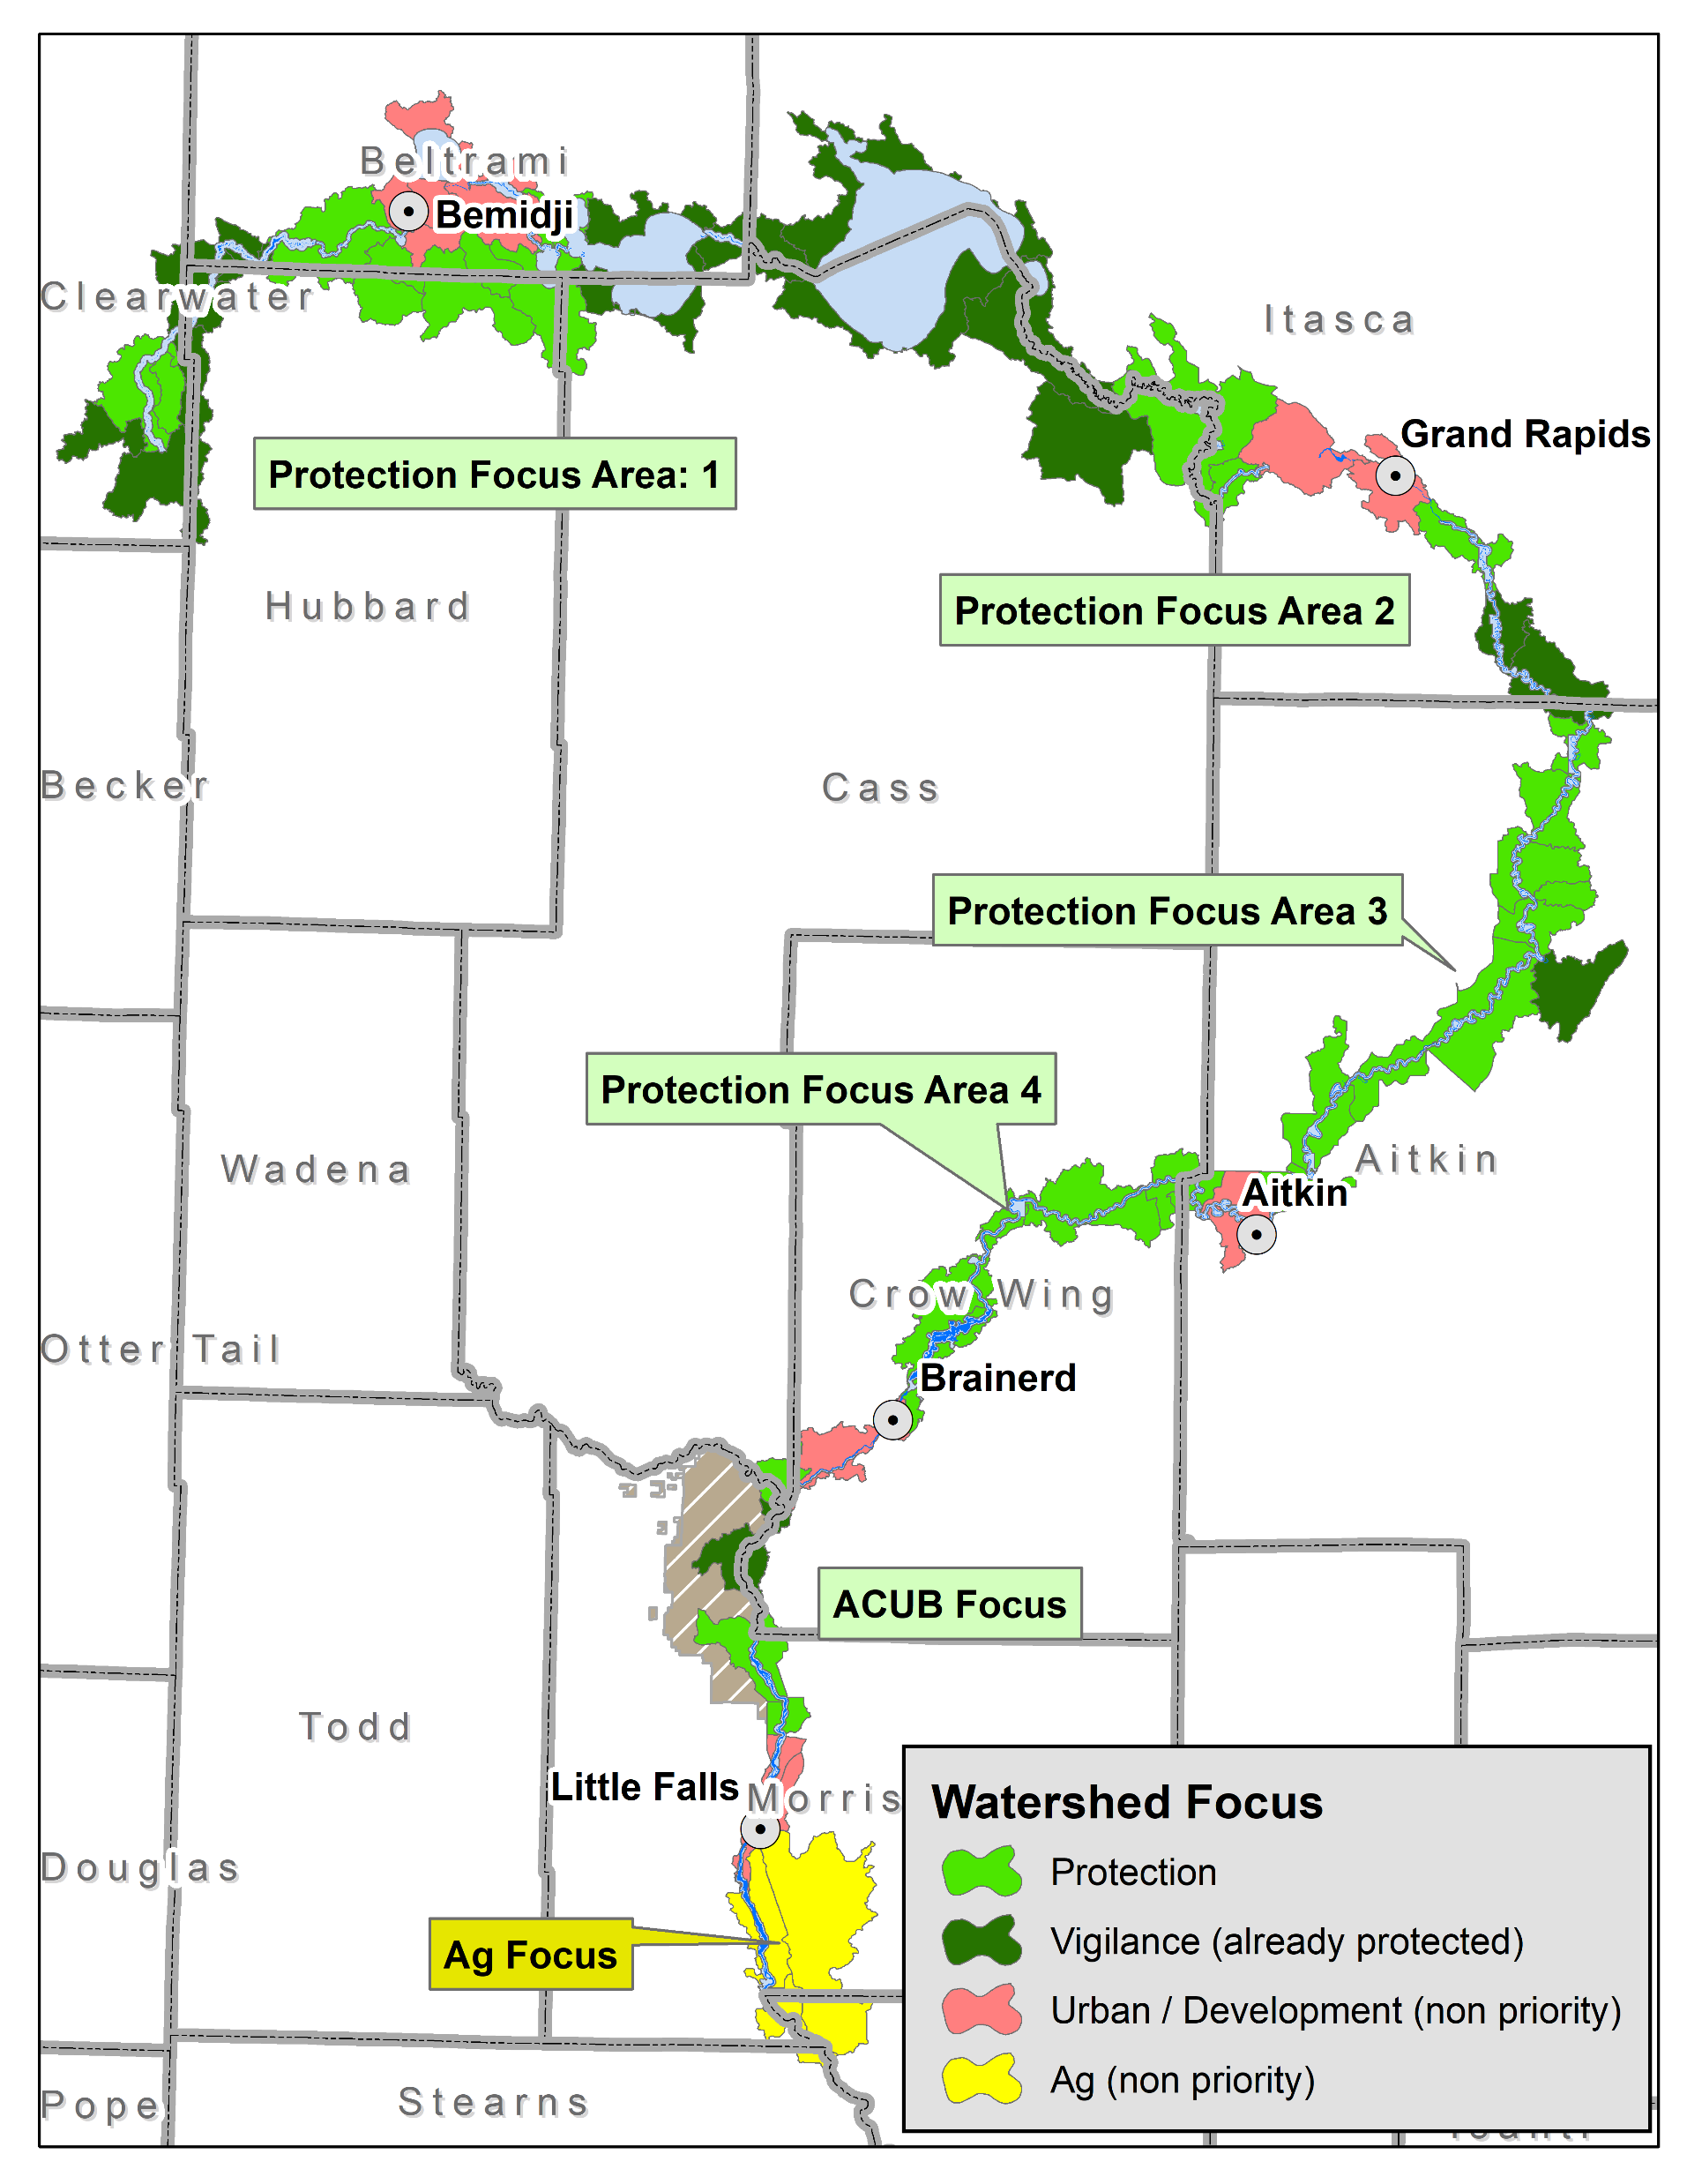
Assessing large scale projects
(first 400 miles of Mississippi River)

Slide 28
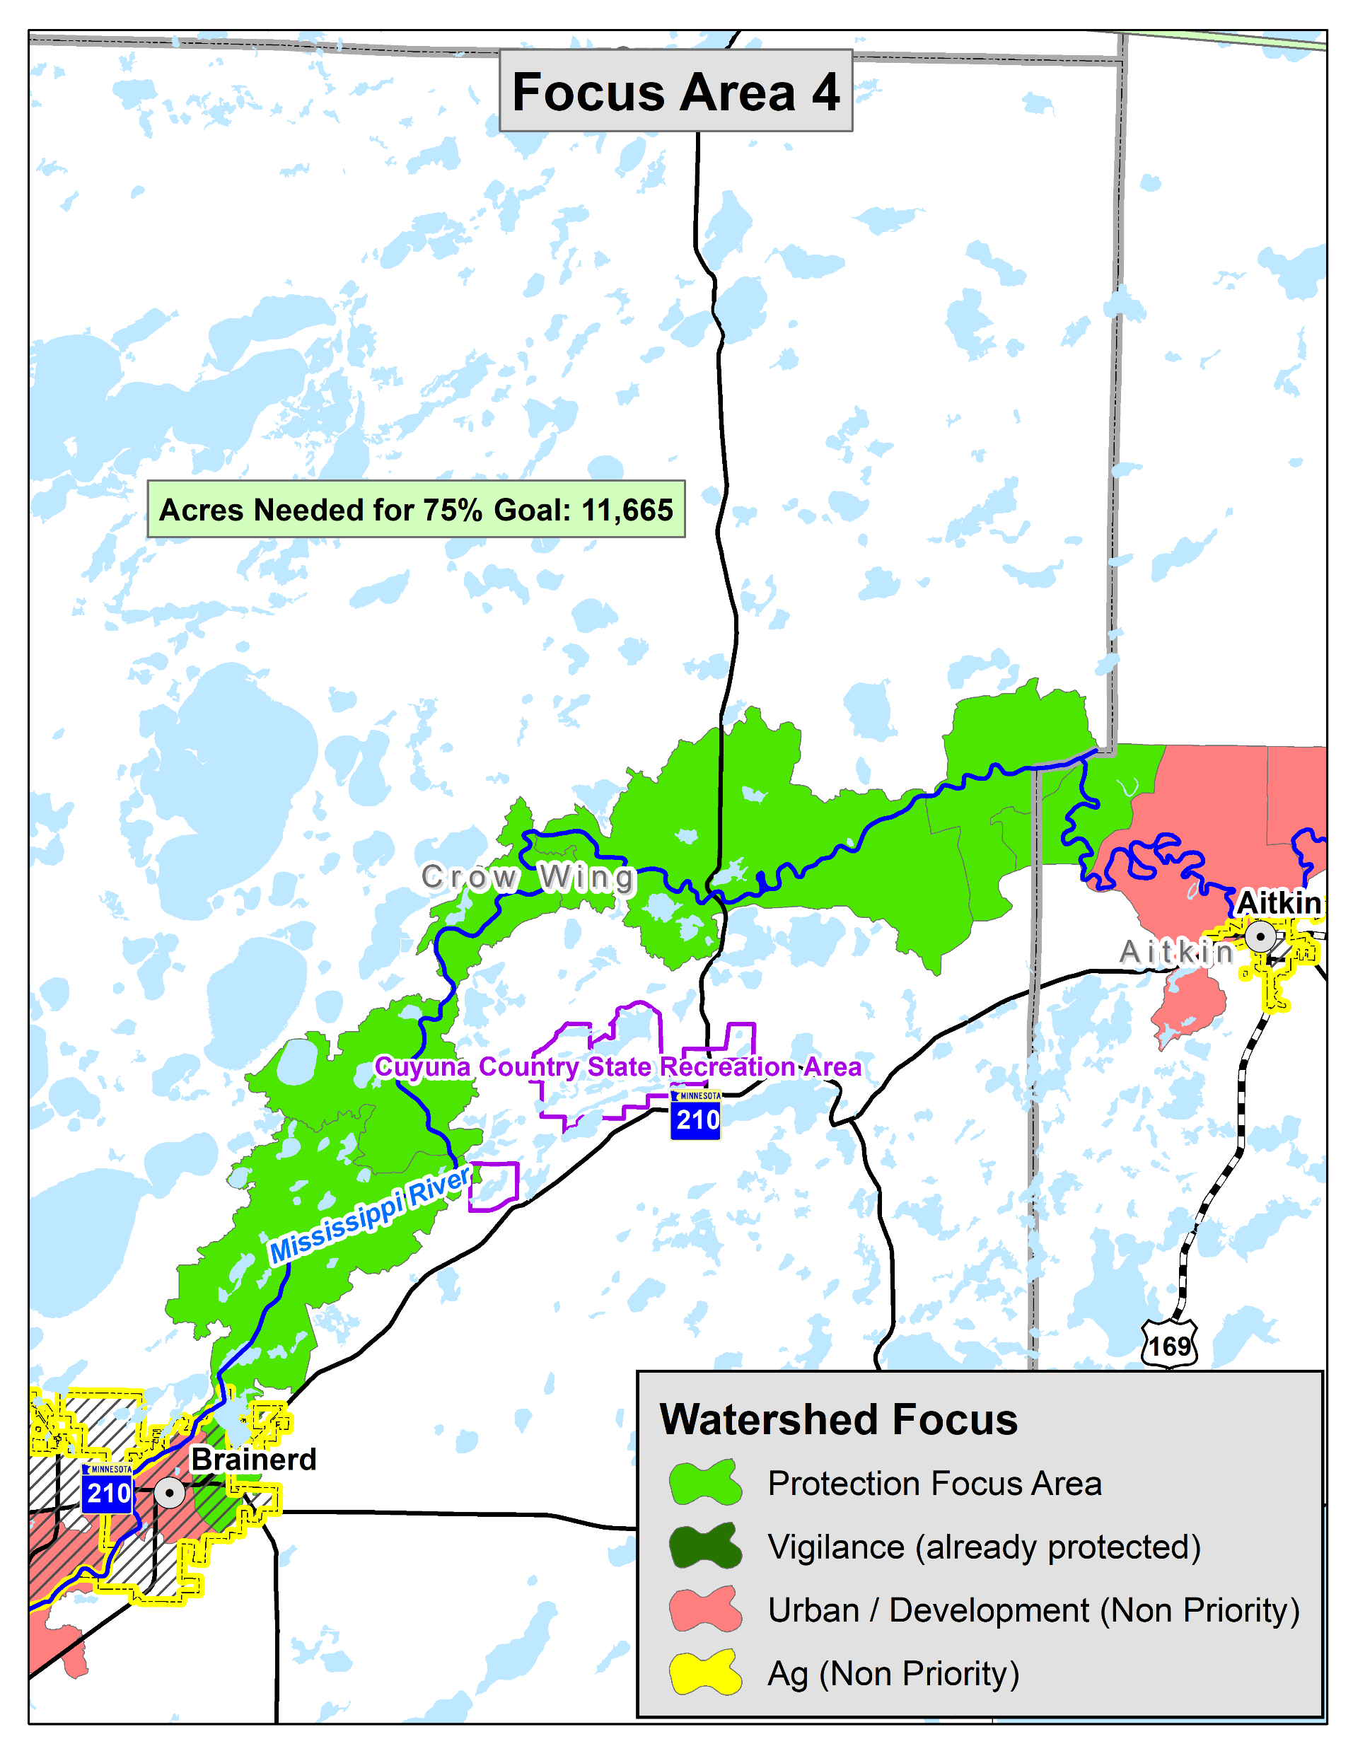
Mississippi river conservation area 4 acres needed for 75% goal: 11,665

Slide 29
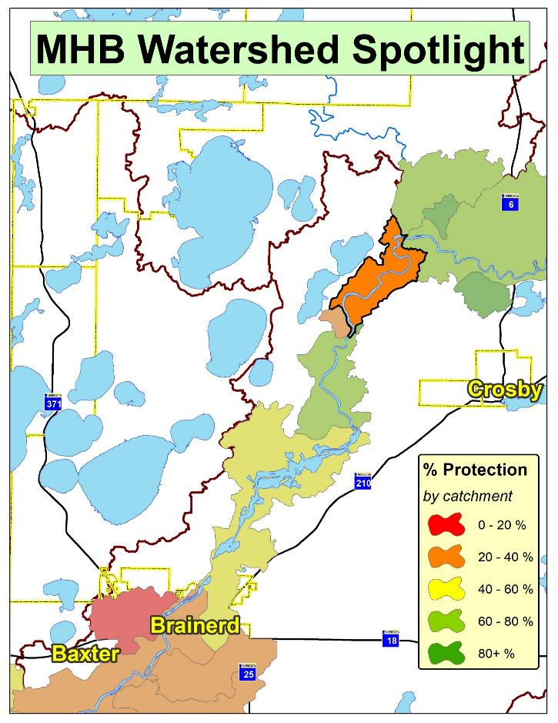
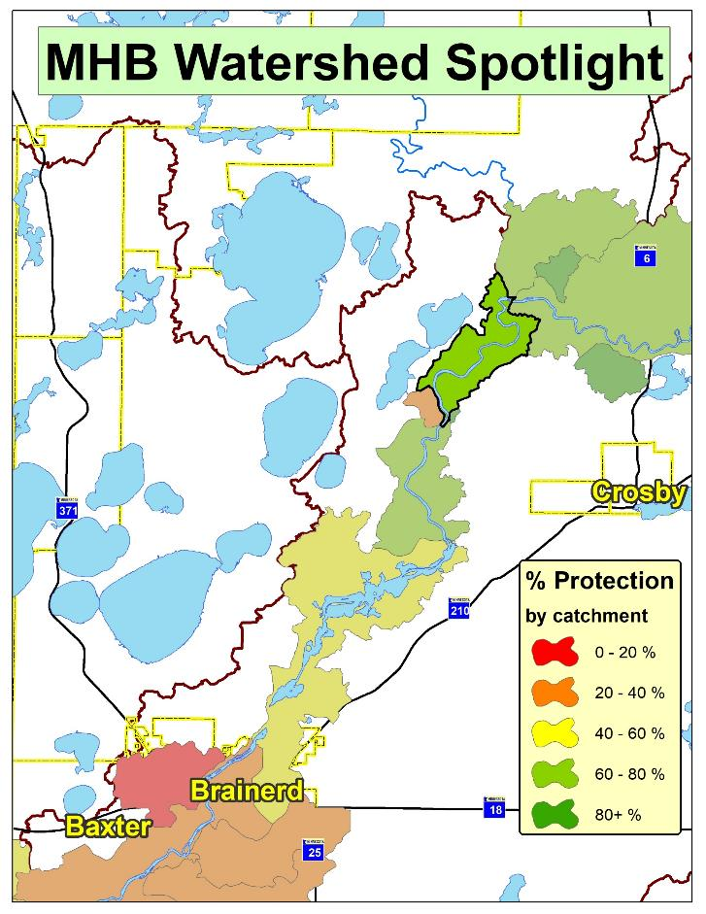
Implementation Success Story: Mississippi
37% Protected as of 2017
71% Protected as of 2019

Slide 30
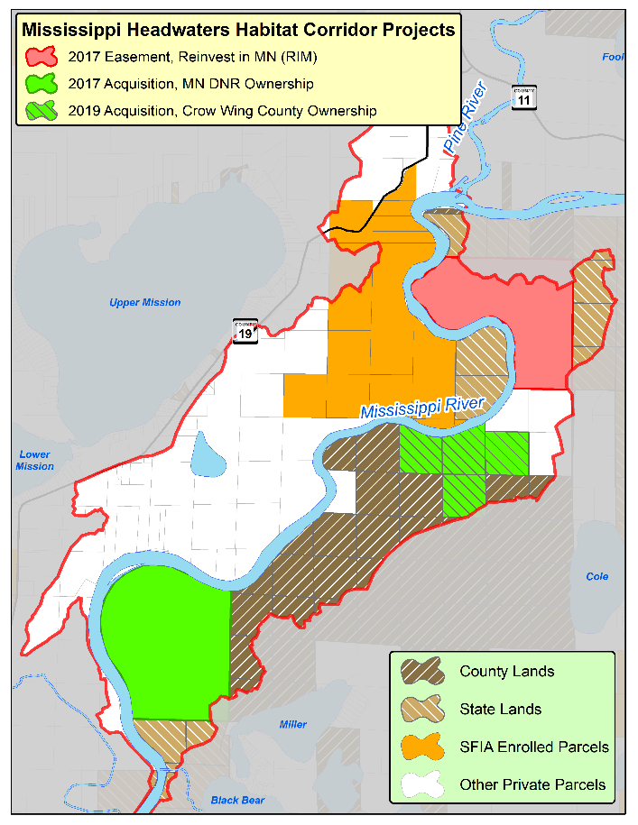





Implementation Success Story
37%
46%
w/ Public Lands
w/ 2017 Acquisition
51%
66%
w/ 2017 Easement
w/ SFIA
Current: 71%
w/ 2019 Acquisition

Slide 31
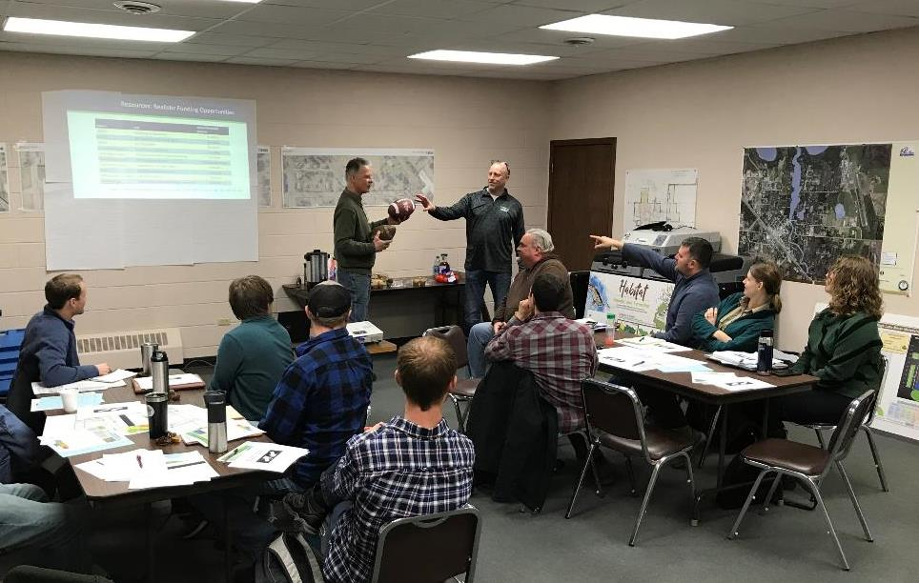
Local teams working together to serve you!
TD!!!

Slide 32
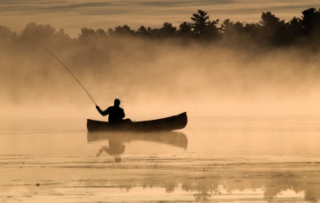
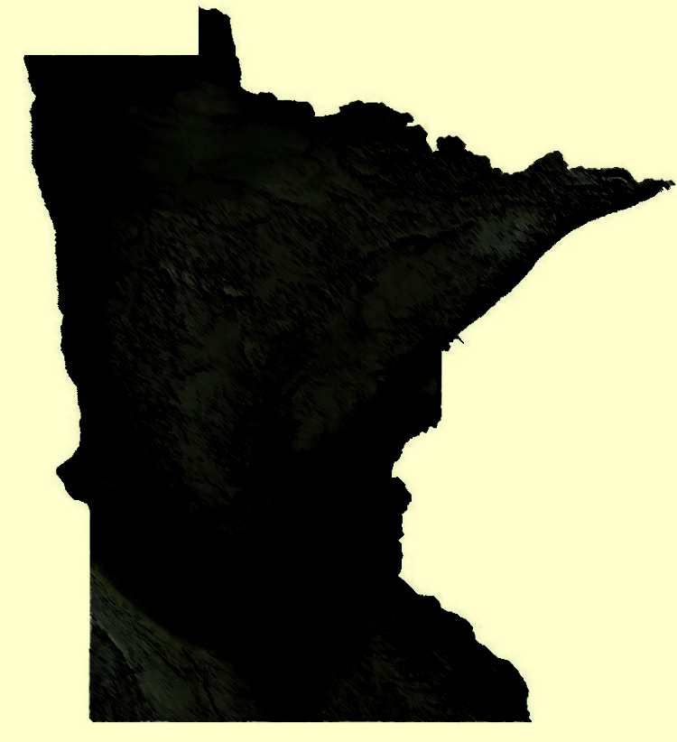

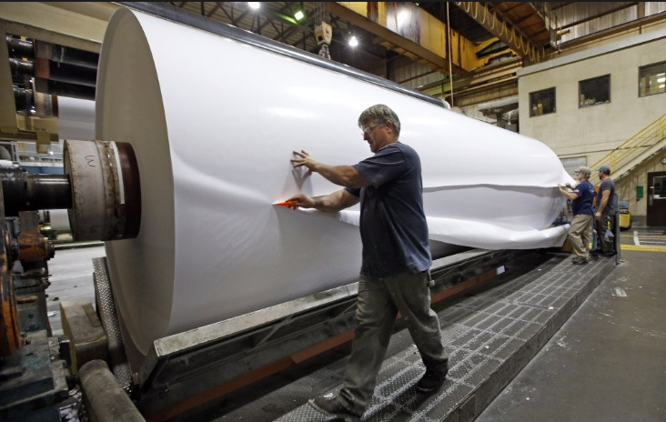
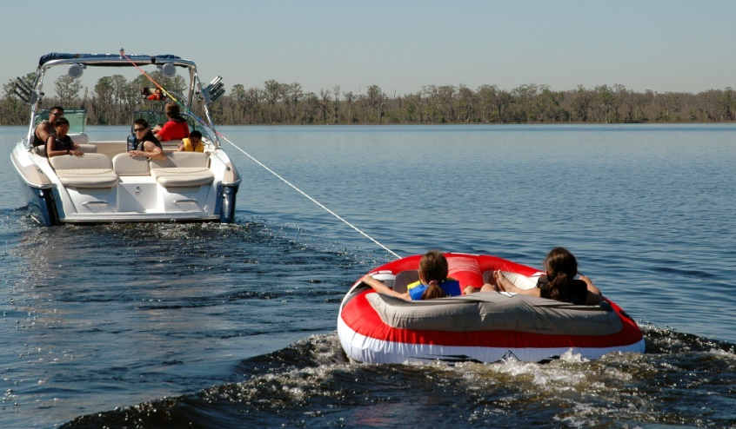
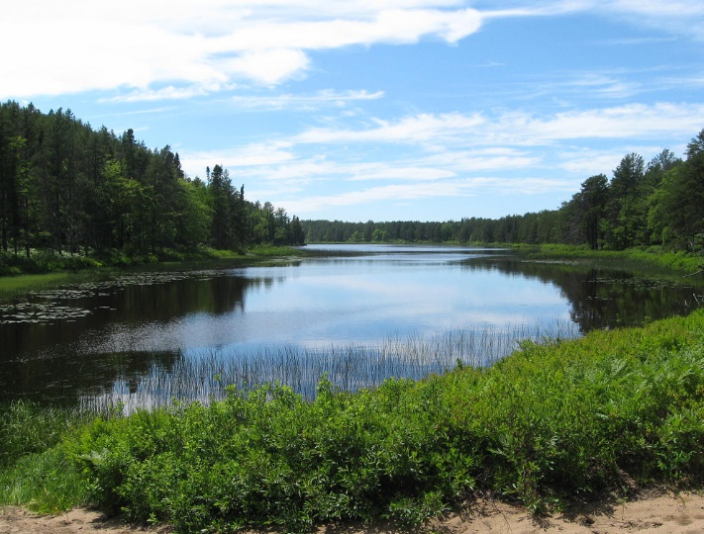
Quality Forests + Quality Water = Quality Life

Slide 33
Contact Information
MN Board of Water & Soil Resources (BWSR)
Dan Steward
Forested Landscapes Planning Coordinator
218-820-1679
Dan.Steward@state.mn.us

Slide 34
Private Forest Management Tools for
Water Quality & Habitat
Fee
Title
Purchase
Conservation Easements
Forest Stewardship Plans
Entry point for most private landowners
SFIA
8-, 20-, or 50- year covenant
Cost-Share
Tree planting, site prep, bud-capping, etc.
Timber Harvest
Permanent protection w/ public access
High Cost
Public Ownership
  Forest protection, permanent
Private Ownership
Lower Cost
Forest protection, 8-50 years
Land owner revenue/forest renewal
Forest improvement
Information/planning

