Slide 1
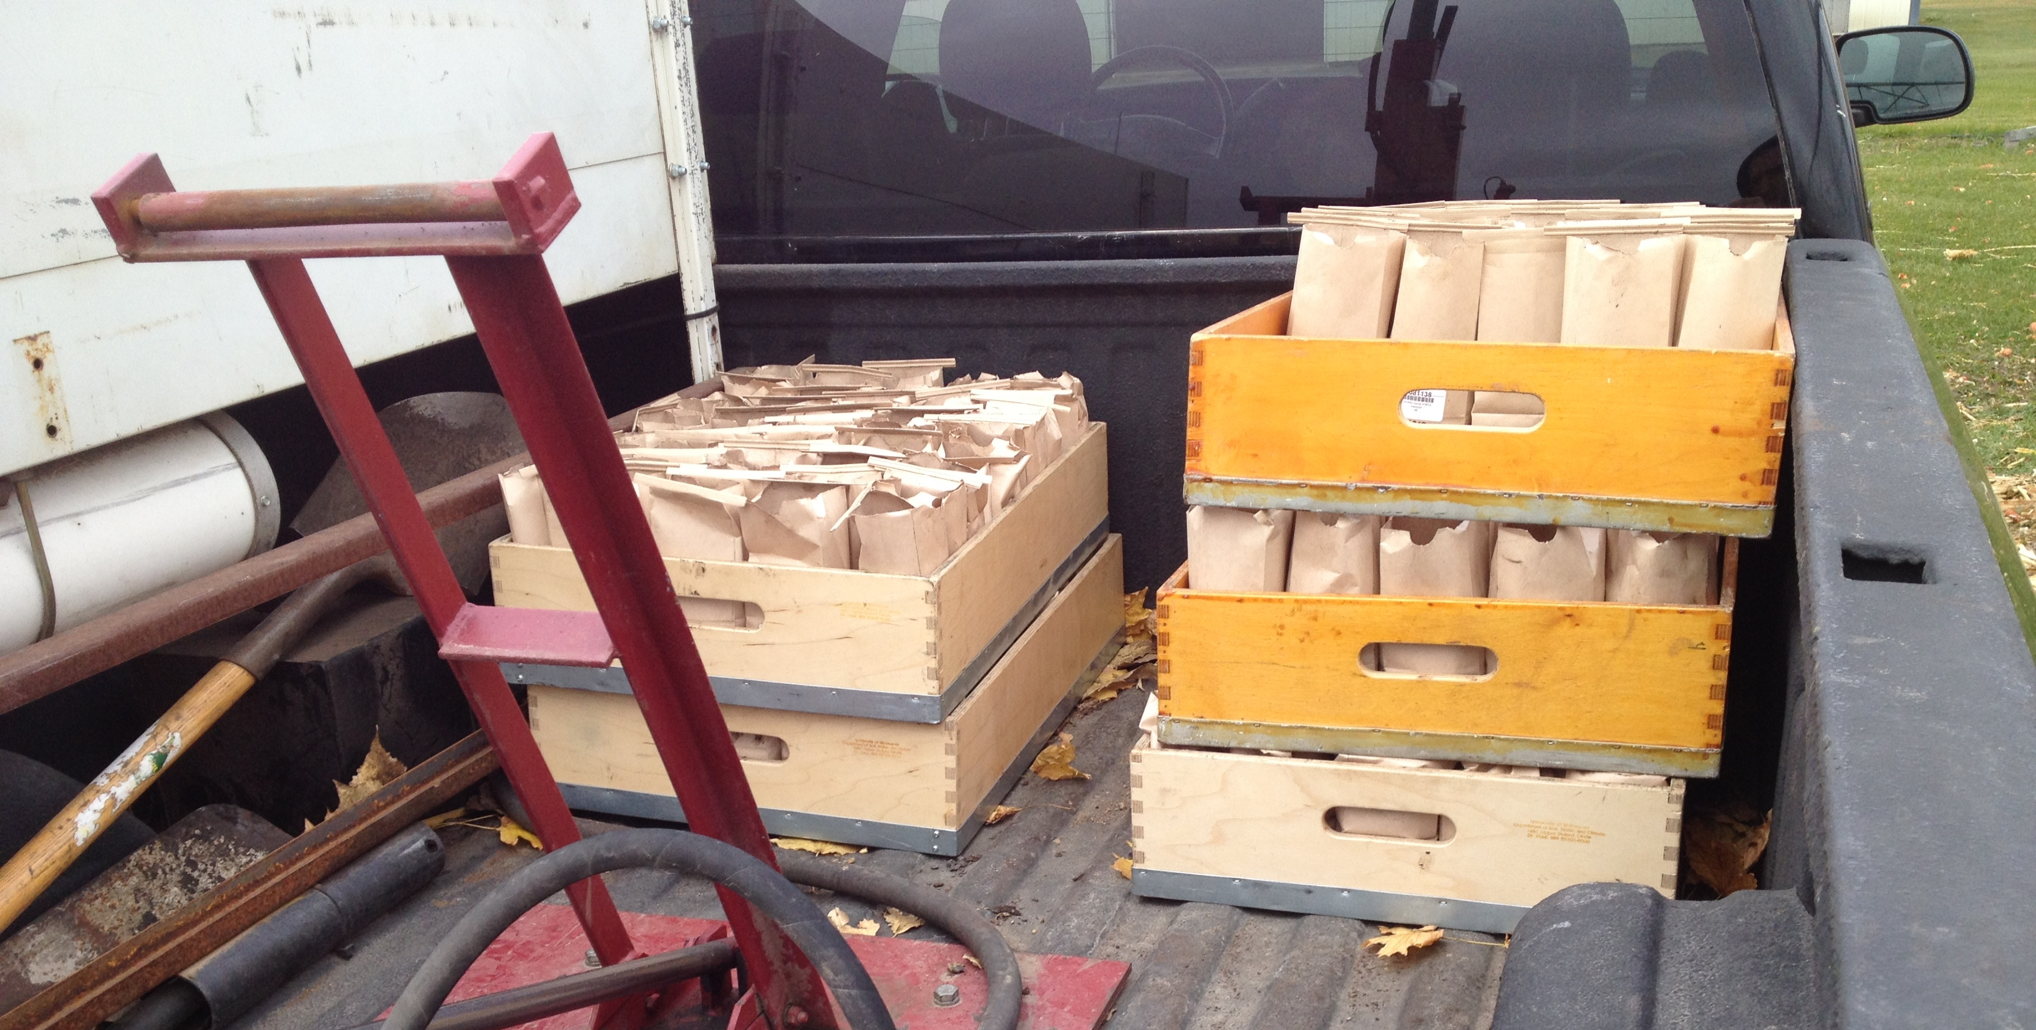
Soil Tests: Separating the Grain from the Chaff
Daniel Kaiser, Brad Carlson, and Fabian Fernandez
BWSR/NRCS Training

Slide 2


Soil Testing
Soil testing IS a useful tool
Soil testing is NOT perfect
  Don’t overvalue its worth
  Natural processes and management practices can make it difficult to translate test results into fertilizer recommendations/guidelines
It is possible to have too much information/data when trying to make a decision

Slide 3
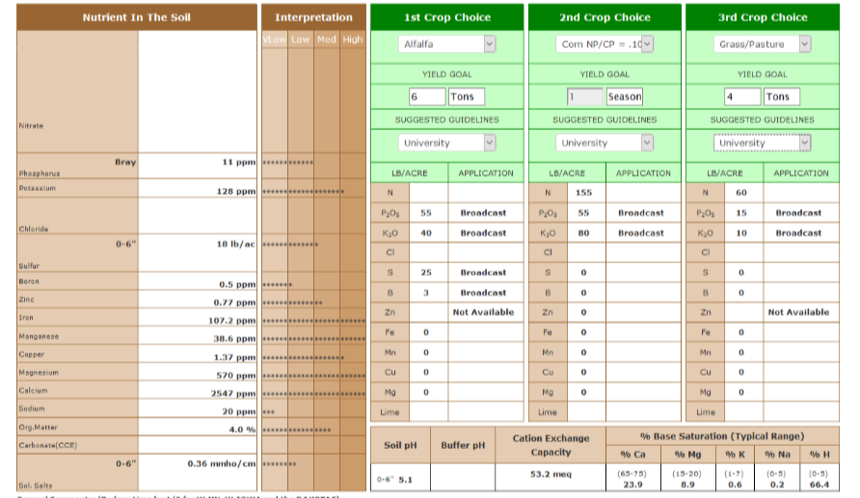
Example Soil Test Report

Slide 4
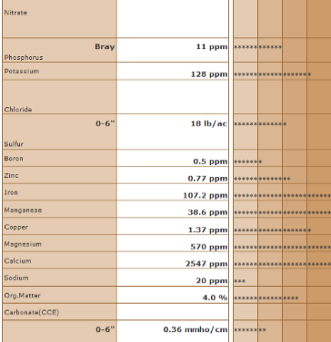

Example Soil Test Report
Why do we use ppm instead of pounds per acre in soil test reports

Slide 5
Total nutrient concentration vs available nutrients in the soil
It is possible to measure total soil nutrient concentration
  Can be a laborious process grinding soil to a finer size and using a long digestion
  Measures all the nutrients even highly recalcitrant forms (primary and secondary minerals)
Plants only see a small fraction of the nutrients in the soil which are bioavailable
  Makes more sense to give an estimate of what is available for plants

Slide 6
Phosphorus example:
Pools of P in the Soil
P chemistry can be complex but typically reacts with Ca, Fe, and Al to form compounds of varying solubility
The amount of available P is low compared to total P
  A low STP soil may have more total P than a high STP soil
K chemistry in the soil is less complex but the concept is the same
  Non labile - labile – exchangeable K
Ca-P
Fe/Al-P

Slide 7
Field Soil Test Correlation – Step 1
Soil tests need to be correlated to crop response to fertilizer in order to be useful
QUESTION – Can’t I just determine the relationship between my yield of a grid zone using my combine yield monitor and grid soil test values?
  Crop response is different than crop yield
How do we correlate soil tests – determine the yield potential (% of max.) for a field area without fertilizer and relate back to soil test values
  FOLLOW UP CONCEPT – Critical soil test values
IMPORTANT – soil tests are correlated for a specific sampling depth

Slide 8
Field Soil Test Calibration – Step 2
Soil test values only indicate the available nutrient in the soil, not the fertilizer required to grow a crop
Field soil test calibration gives meaning to a soil-test value in terms of nutrient sufficiency and fertilizer need
    Units of measurement for test results are meaningless without proper field calibration with yield response
Follow LGU guidelines

Slide 9
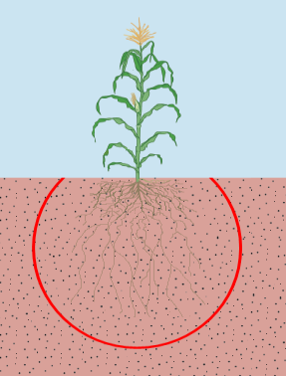
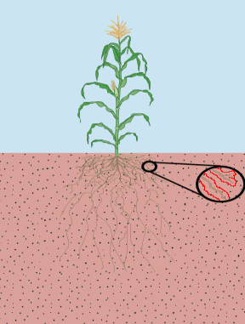
Why is sampling depth important
Soil test must estimate the total nutrient available in the root zone
Nitrogen & Sulfate-S
Soil test is an index of the quantity available to the plant
Phosphorus, Potassium, & micros
Root surface sorption zone
Mobile nutrients move into the plant with water
Most immobile nutrients are taken up by fine root hairs in the top 6-8” of soil
Root system sorption zone

Slide 10
What if my report is in ppm and I need lbs per acre or vice versa?
It is generally assumed that an acre furrow slice of soil weighs 2,000,000 lbs
  Acre furrow slice = 1 acre area 6” deep
  Labs convert to lbs per acre by multiplying ppm x 2 for every 6” sampling depth
Results from mobile nutrients typically represent more of the total available fraction and it is common to see values reported as lbs per acre
  Nitrate or sulfate-S at 2 ft depth : ppm x 8
Results for immobile nutrients SHOULD NEVER BE USED if reported in lbs per acre
  If reported in lbs per acre divide by 2

Slide 11
Other Factors to Consider
Fertilizer recommendations for phosphorus and potassium are given in lbs phosphate (P₂O₅) or lbs potash (K₂O) per acre – DO WE NEED TO CONVERT OUR SOIL TEST VALUES??
Soil tests are reported as concentration of P or K but indexes of availability and can be considered unit less
A manure analysis is different and units may need to be converted
  P to P₂O₅ – multiply by 2.29
  K to K₂O – multiply by 1.20
  If you need the reverse then divide by those factors

Slide 12


This is no K₂O in 0-0-60 fertilizer (Potash, KCl)
Why do we report in oxide forms

Slide 13
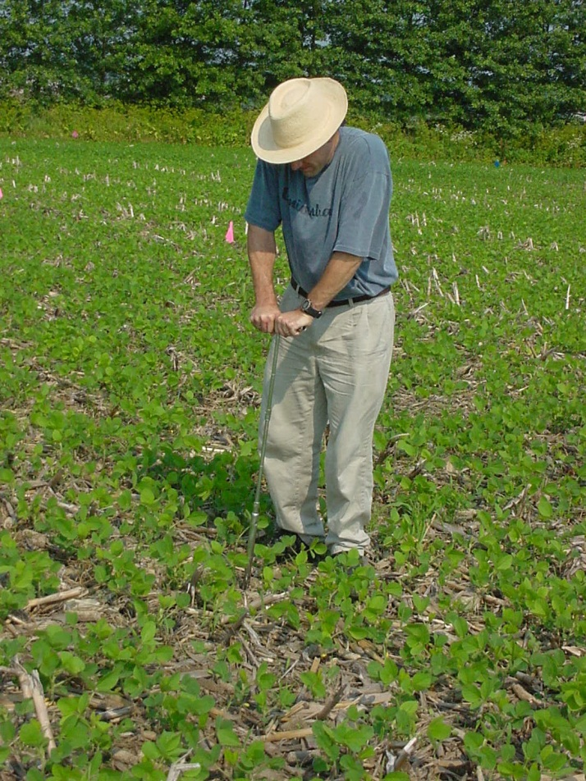
Soil Sampling for P, K, pH
The greatest source of inaccuracy in a soil test value is typically associated with the technique used to collect the sample
Factors to consider
  Sampling tools
  Number of samples
  Method of sampling
  Depth of sample
  Time of sampling
  Frequency
  Handling of sample
  Test and labs

Slide 14

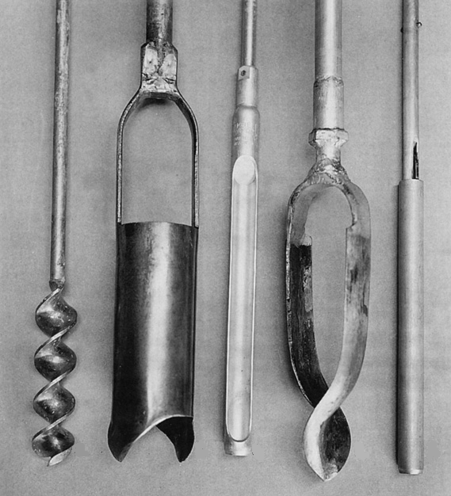
Having the Right Tools!
A soil probe
Auger
Spade
Clean bucket
Clean sample bags
equal amounts of soil
from a certain depth

Slide 15
How to Take a Soil Sample
Clear crop residue on the soil surface
Make a composite sample by placing 10-20 cores in buckets and mix thoroughly
Place approx. 2 cups of soil in a labeled sample bag (name, field id, sample number)
Mark location of sample on an aerial map, drawing, or using GPS to reduce in-field variability problems
Most analysis only use 1-2 g of dried soil

Slide 16
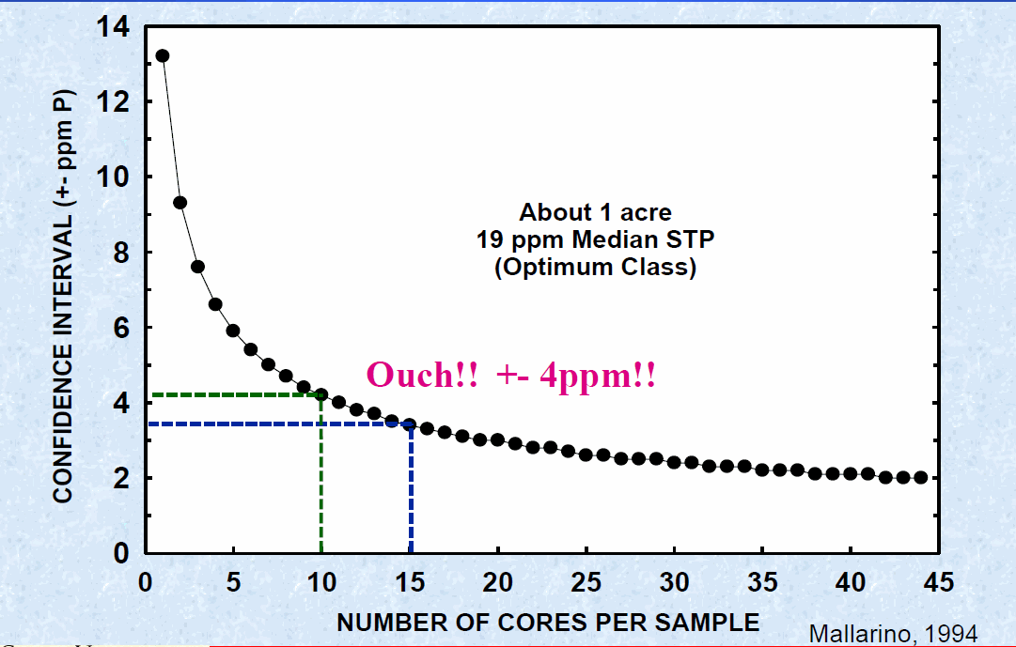
How Accurate is Your Soil Sample

Slide 17
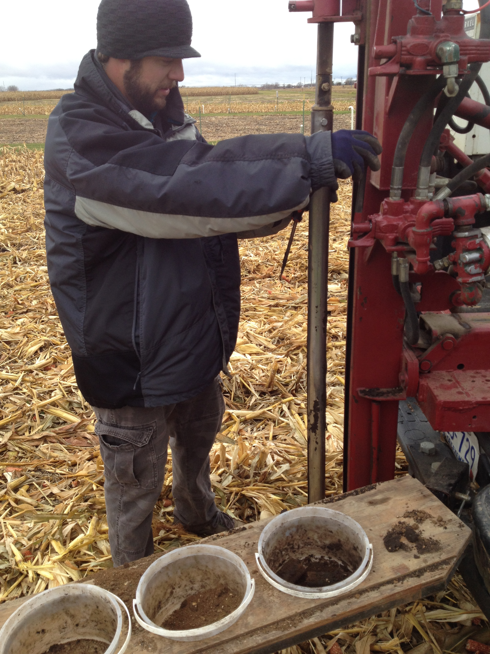
Method of Sampling
Different strategies
  Whole field
  Grid
  Zone
Strategy is determined by:
  Expected fertilizer management approach
  Sampling history
  Existing fertility level

Slide 18
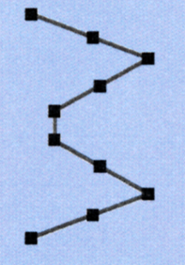
Whole Field (at least 10 core-composite collected in zigzag)
  Avoid these areas:
  Low yielding
  Dead furrows
  Drainage problem
  Old fence line
  Cattle feeding
  Manure/lime piles
  Eroded knolls
  Banded fertilizer rows
Used for a single fertilizer rate across field
Gives an unbiased estimate of the mean soil test value
Pros – relatively cheap
Cons – no information on nutrient variability

Slide 19
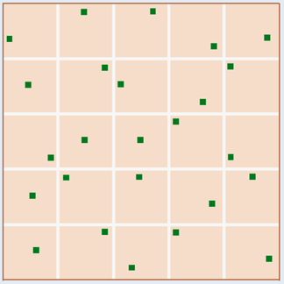
Grid sampling (At least 5 cores per 5’ radius grid point)
Use for variable rate applications (VRT)
Can be useful in rent/newly purchased land with no records of past history
Use GPS to know where samples were taken
Pros – good determination of nutrient variability
Cons – expensive

Slide 20

DEALING WITH SOIL TEST VARIABILITY
180 X180’ GRIDS
360 X 360’ GRIDS
H
M
M
VH
H
M
H
H
L
H
L
L
H
M
M
60 X 60’ GRIDS
Lamb and Rehm – U of M
VH
VH
H
H
VH
VH
M
M
L
L
M
VH
M
H
L
L
L
L
M
N
VH
M
M
VL
H
M
VL
L
L
M
VH
L
M
H
L
M
L
L
M
VH
M
H
VH
VH
H
H
L
M
H
VH
L
L
M
M
L
L
M
M
VH
VH
VH
M
M
L
L
L
L
M
M
L
M
L
L
M
M
L
L
VH
M
M
M
M
VL
M
VL
L
H
VH
H
L
M
VH
M
VH
M
L
L
L
L
M
L
L
L
L
H
VH
VH
VH
M
M
M
L
M
L
L
Renville Count soil P test classifications

Slide 21
Zone Sampling
Used where management may be different across a field
Zone borders and/or sampling points can be georeferenced
Pros & Cons
  Provides an assessment of variability better than whole field, not as good as grid
  Cost Effective

Slide 22
Zone Sampling
Zone delineation – based on knowledge of the field
  Soil and/or yield maps
  Topography/elevation map
  Past/present management
  Nutrient maps from previous grid sampling
Follow whole field sampling intensity guidelines, considering the zone a field

Slide 23
Zone Delineation
15 T/a manure
last year
Formerly 2 fields
now all 1 field
Limed 4 years ago
Never limed
No manure
2 zones
2 zones
2 zones
Clay Loam
Gentle slope
Well drained
Sand
Steep slope
Well drained
Flat
Poorly drained
Clay
3 zones
3 zones

Slide 24

Frequency
Strongly suggested every 4 years
  High or very high soil test and maintenance rates are applied
More often (2 years)
  Low CEC (light texture soils) at any test level
  No maintenance fertilizer rates being applied
  Major changes in pH or soil test are being done
  Intensive removal (continuous corn silage, alfalfa hay)
Source: AP Mallarino, ISU
Source: A. Mallarino

Slide 25
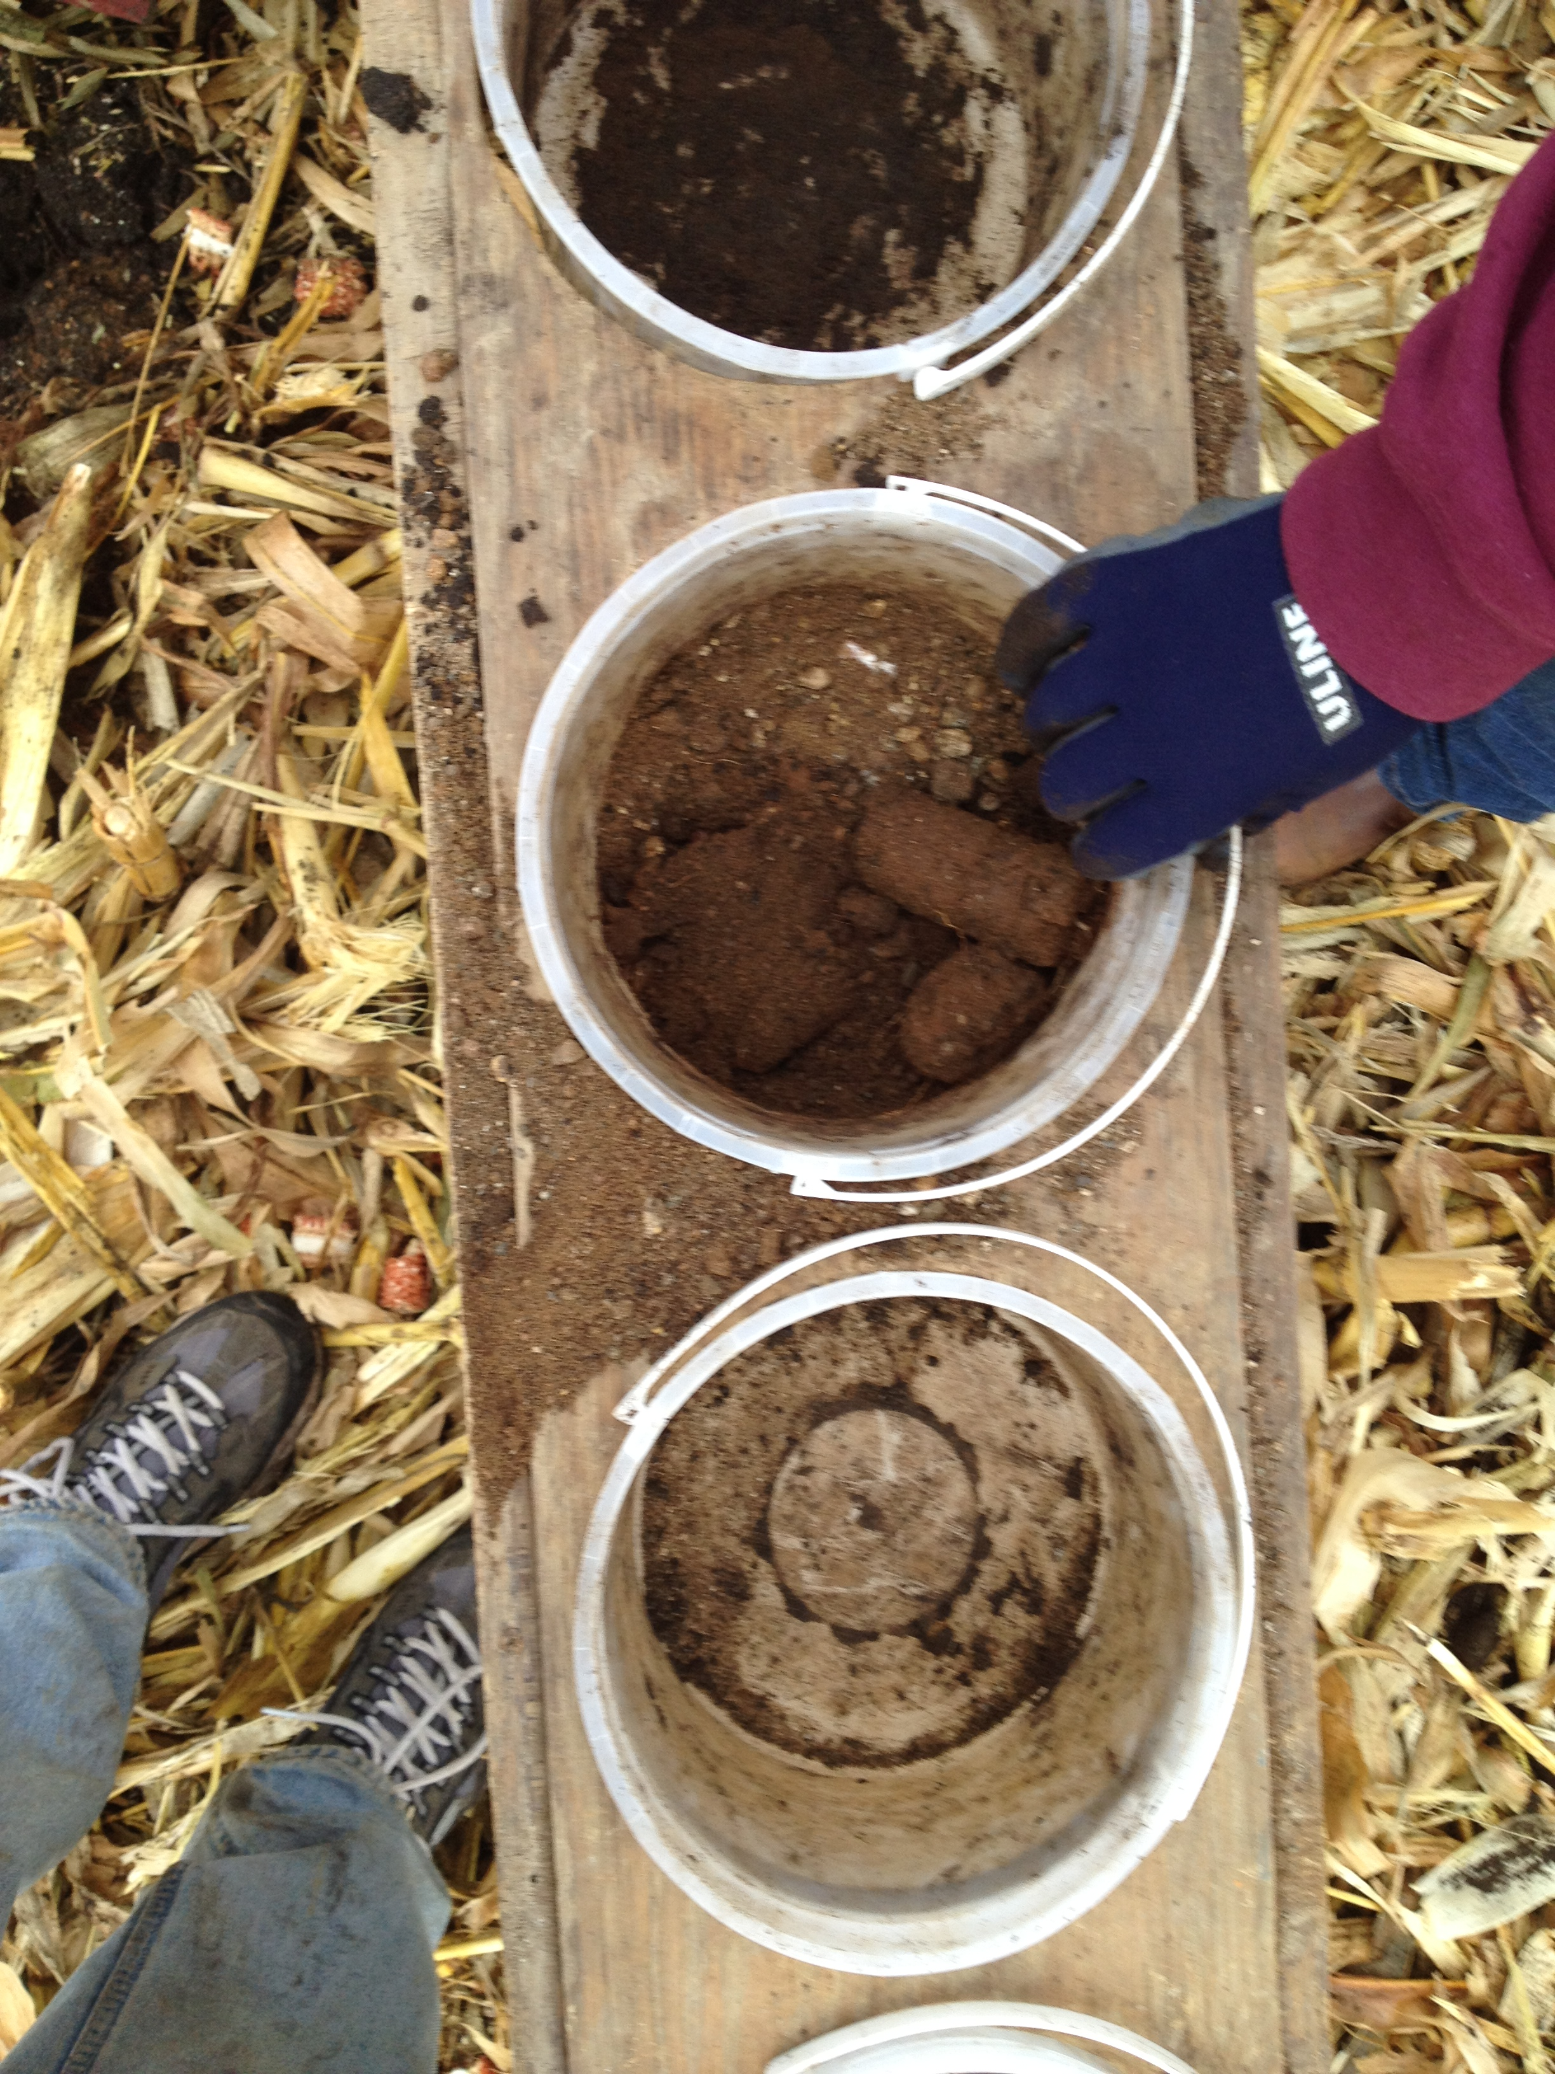
Handling of Samples
If you are not keeping all collected cores: completely break an mix cores to obtain a homogeneous sample
High soil temperatures increases K release rate (Don’t oven dry soil samples being tested for K)
Consider air dying soil on a paper plate if the sample will not be submitted soon

Slide 26
Labs
Use certified commercial soil-testing labs
  The North American Proficiency Testing (NAPT) Program (Soil Science Society of America) https://www.naptprogram.org/
Choose one and stay with it
In state labs tend to run soil tests suggested for use in MN
Out of state labs may run non-suggested tests but may report values by converting values to a suggested test using in house correlations
  THIS CAN BE A MAJOR ISSUE ON SOME SOILS
Try to sample fields at the same time of the year

Slide 27

What is important and what is not?

Slide 28
What tests do you need to run
Most labs will offer packages for certain crops which offer various tests deemed “important”
Bare minimum a sampled should include P, K, and pH
  Soil pH is less important in high lime soils with pH > 7.4 as pH is less likely to change over a short period of time
If you are sampling a field for the first time then I would also include soil organic matter and DTPA test for micro nutrients
  Zinc is the micronutrient most of interest in Minnesota
If you are interested in nitrate, sulfate-S, or chloride then you may need a deeper soil sample
  0-6” plus as a 0-24” or 6-24” sample

Slide 29
What Soil Tests are Used in Minnesota
Two phosphorus soil tests are suggested for MN
  Bray-P1 test when pH 7.4 or less
  Olsen P test when pH >7.4
  For fields with high pH inclusions the Olsen test could be used across a field (Bray works better if pH 5.0 or less)
The Bray-P2 test IS NOT recommended for use in MN
  More acidic than the P1 test and was designed for use in soils treated with Rock phosphorus
The Haney H3A test is a weak organic acid extraction and has been shown to correlate to most other P tests
  High pH soils can present issues for the H3A test
Morgan and Mehlich 1 are used on the east coast
FOLLOW UP CONCEPT – Soil test P comparisons

Slide 30
Why Don’t we use the Mehlich-III test
The Mehlich-III test is used in neighboring states and is a Universal extractant for many nutrients
For Phosphorus
  It can work con high pH soils as it is more buffered but may extract higher amounts of P in some high pH soils
  If P is determined colorimetrically the soil test concentration will be ~5% > than Bray-P1
  If P is determined by ICP then it will be ~20% > Bray-P1
For Potassium
  Results are similar to the ammonium acetate procedure
For Micros
  Results show Mehlich-III correlates to the DTPA test for some of the micros but not all – M3 Zn will be higher than DTPA
For Sulfur and Boron
  It gives you a number

Slide 31
Other Tests
Nitrate-N is determined following extraction with 1 or 2M KCl
Potassium, Calcium, Magnesium, and Sodium are determined with extraction in 1M ammonium acetate (pH 7.0)
  K extracted is determined by atomic absorption or ICP
Copper, Iron, Manganese, and Zinc are extracted with DTPA (chelate)
  Values are determined by atomic absorption or ICP
Boron is determined by extraction with hot water
We suggest sulfur determination using mono-calcium phosphate – labs vary (I do not suggest using sulfur data for determine how much S to apply)
  Organic matter concentration is a better indicator

Slide 32
Other Tests - Continued
Soil organic matter is determined via loss on ignition
  Heat the soil sample to a high temperature and measure mass loss
Soil pH is measured 1:1 soil:water using a pH electrode
  Soil pH is used to determine when lime should be applied
  IMPORTANT – Buffer pH is used to determine lime needs
  FOLLOW UP CONCEPT – Liming reaction
Cation exchange capacity
  It is best to measure CEC by cation saturation/displacement
  Flood the CEC with a cation (NH₄⁺) then displace
  Most labs use the summation method measuing bases with ammonium acetate or M3
  CEC can be overestimated in high pH soils

Slide 33
Important points to remember
CEC and soil organic matter are relatively stable over time so they do not need to be run all of the time
Soil nitrate-N, P, K, and pH will be more variable so analyzing every 2-4 years is warranted
  Identify what is short term variability versus long term trends when working with growers
Sampling depth is important no matter what tillage is used
  I have had growers submit 0-12” samples for P, K, and pH because of deeper tillage depths but this can dilute a sample and lower soil test values
Calibrations for a specific nutrient for a single soil test will likely not be relevant for a different test

Slide 34
Concepts to Follow up on Later
Phosphorus, Potassium, and Sulfur cycles
Sources of fertilizers
Agronomic management of P, K, and S / Fertilizer guidelines
Fertilizer placement
Environmental issues related to macro and micro nutrient application
Liming of soils

Slide 35


